Slide 1
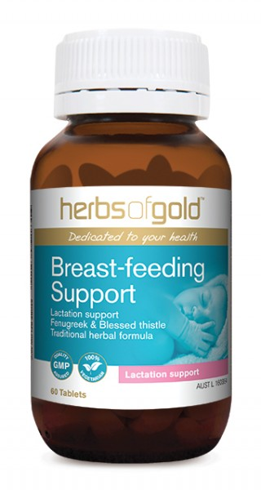
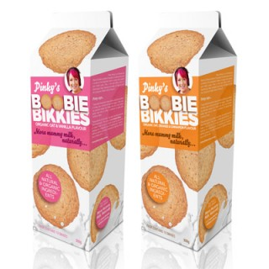
Galactologues
Should we recommend herbal galactologues or ‘lactation cookies’?

Slide 2
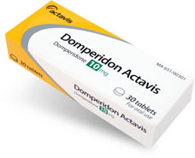
Domperidone for increasing milk supply
Is not a magic pill!
It may help some women to boost their supply
It does not work alone…i.e. the mother cannot be expressing 4-5 x daily and take Domperidone and her milk supply will increase.
The breasts still need correct stimulation despite taking Domperidone
Frequent expressing = reduction in FIL = increase in milk made
Infrequent expressing (<6-8) = increase in FIL = reduced milk made

Slide 3
How much to express when the preterm infant is commencing breastfeeding?
Always protect the supply
Continue expressing milk until breastfeeding well with every feed – (i.e good weight gains with breastfeeding alone)
Expressing after feeds or when baby is not breastfeeding is advised to maintain a good enough supply for most women.
It may be a gradual and slow process to full breastfeeding even after discharge – reassure the mother!

Slide 4
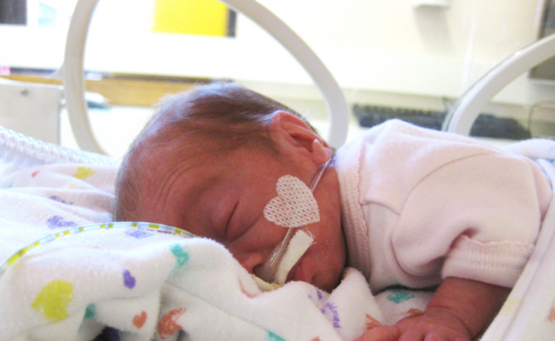
Three key points
Early expression and prolonged skin contact
Give real advice – frequency of expression and demonstrate effective technique
Monitor & document milk volumes

