Slide 1



Strengthening Hospital Responses to Family Violence
Senior Management Engagement

Slide 2
Why strengthen our response to family violence?
  Hospitals are in a unique position to identify & respond to family violence
  Health professionals identified as people to trust with disclosure
  A problem in our community affecting our patients and staff
  Family violence is a health issue across the lifespan
  The SHRFV Project provides access to a best practice approach
  DHHS support through the SOP/ funding
  Part of the Royal Commission into Family Violence was the need for hospitals to strengthen responses

Slide 3
The SHRFV Project background
DHHS funded The Women’s & Bendigo Health in 2014 to develop a best practice service model that could be applied & adapted state wide
Initial project scope was violence against women & intimate partner violence – expanded in 2017 to a family violence across the life span approach
27 hospitals now funded and 62 supported to implement the SHRFV model
Aim is to have all public hospitals implementing the SHRFV model by 2020, and thousands of staff trained across the state
SHRFV Tool Kit to support implementation

Slide 4
A definition of family violence
Family violence is behaviour by a person towards a family member that:
  is physically or sexually abusive
  is emotionally or psychologically abusive
  is economically abusive
  is threatening or coercive or dominating
  causes fear
This definition also includes behaviours that cause a child to witness or hear or otherwise be exposed to the effects of family violence.
      (Victorian Family Violence Protection Act 2008)

Slide 5
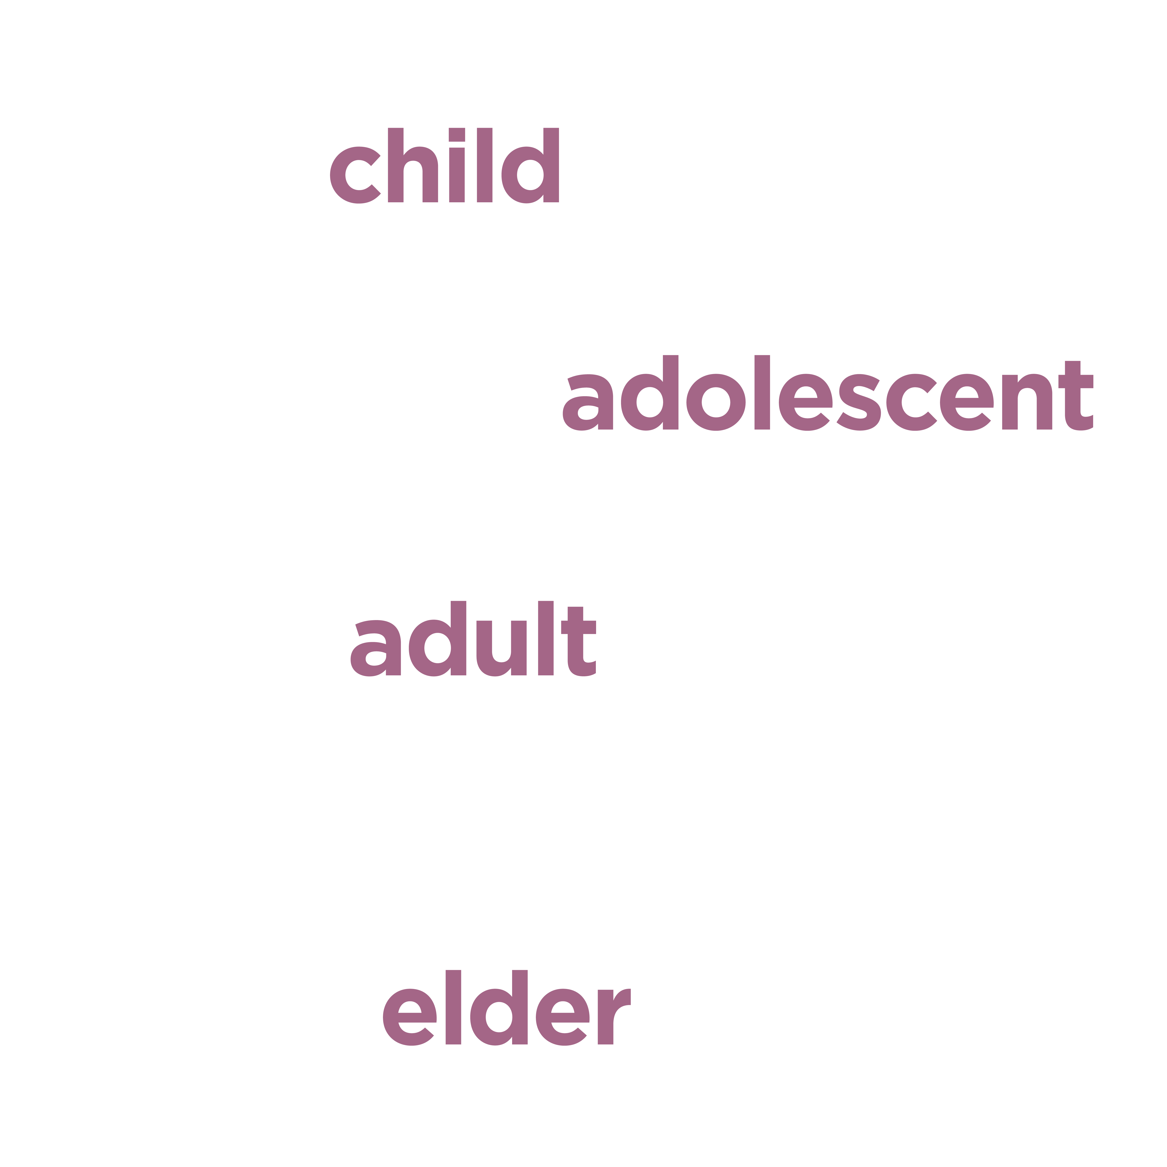
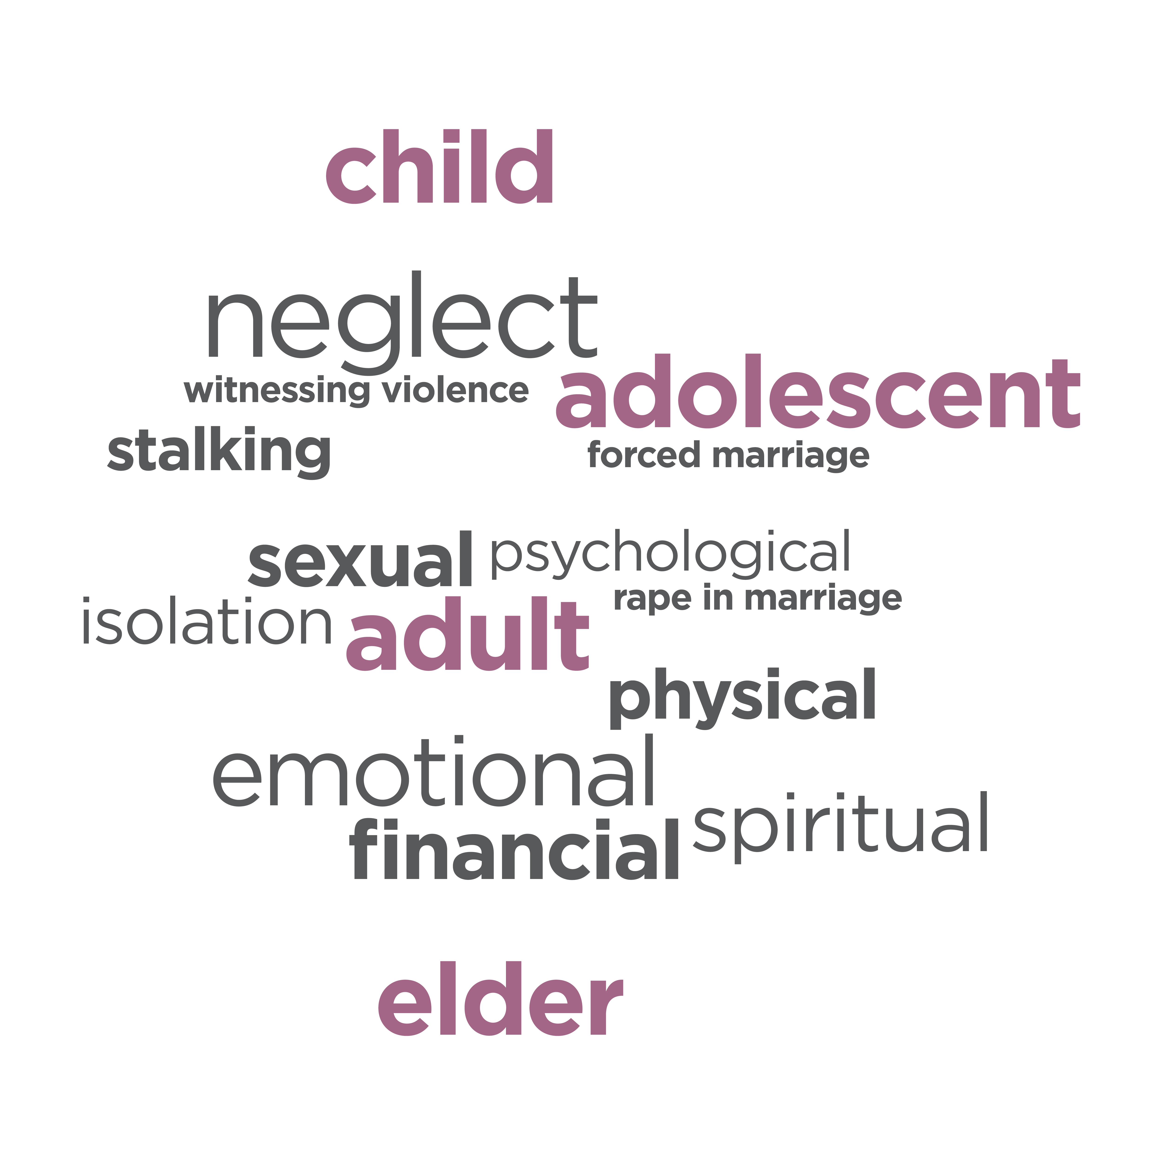
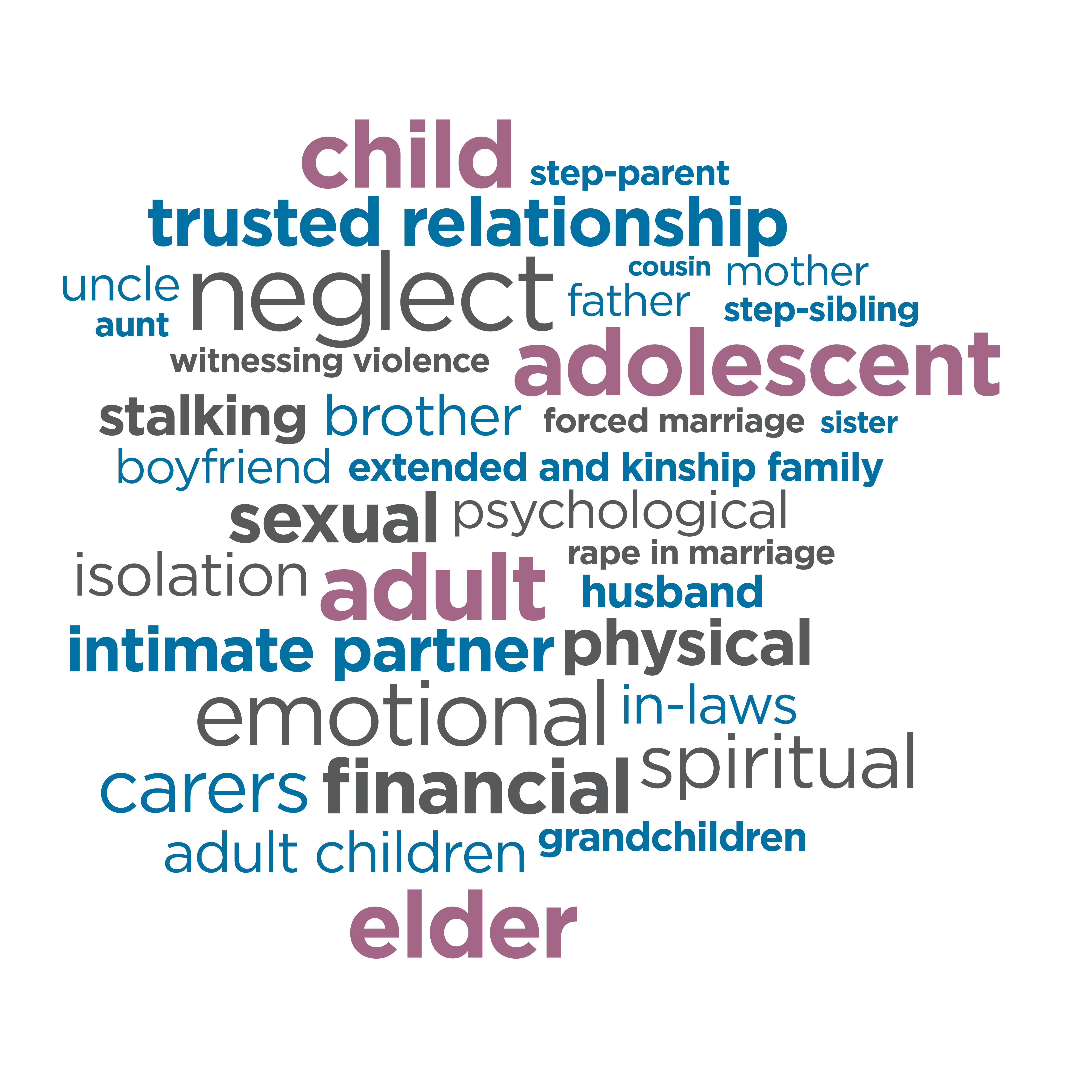
Family violence is complex
It occurs throughout the lifespan.
There are many types of abuse.
And many different perpetrators.
Notes:
This diagram shows that family violence extends across the lifecycle, there are many different types of family violence and that it can be perpetrated by many different people with varying relationships to the victim/survivor
Family violence ‘may involve partners, siblings, parents, children and people who are related in other ways. It includes violence in many family contexts, including violence by a same sex partner, violence by young people against parents or siblings, elder abuse, and violence by carers in a domestic setting against those for whom they are responsible.’ (Victorian Family Violence Protection Act 2008)

Slide 6
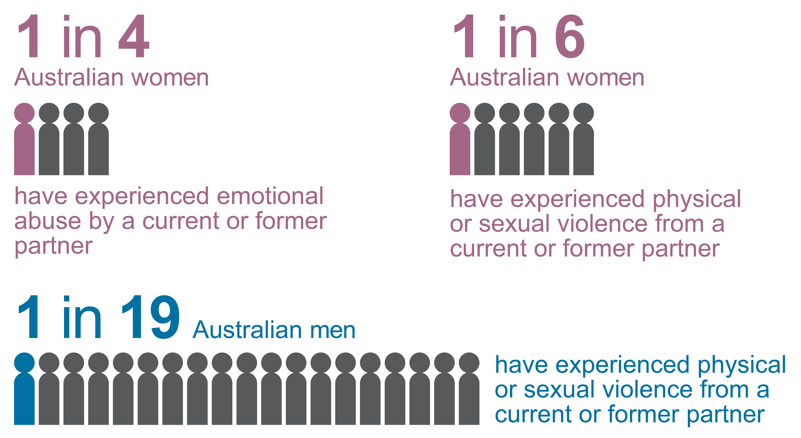
Prevalence of family violence
Notes:
Infographics based on ANROWS statistics
Victims of family violence are predominantly women and children, males can also be victims, particularly as children and in their older years.
Not all incidents of family violence are reported to police which is why a health system intervention is so important
The rates of abuse and assault are also vastly underreported as people don’t always recognise the abuse as family violence
As health practitioners, we work with people who have experienced family violence and sexual assault everyday.
KEY MESSAGES:
Victims of family violence are mostly women and children
Many people are affected by family violence and they are our patients and our colleagues.

Slide 7
other facts
  On average, at least one woman dies at the hands of a current or former partner every week in Australia
  1:3 women experience physical violence, since the age of 15
  More than half of the women who experienced violence had children in their care when the violence occurred
  Elder abuse underreported but thought to affect at least 5 percent
  1:3 LGBTIQ Australians report having been in an abusive relationship
Notes:
Ref.
Women in Australia are at least three times more likely than men to experience violence at the hands of a partner
Indigenous women experience disproportionately high levels of family violence and more severe forms of violence compared to other women
Many people are at risk – around the birth of a child is particularly risky, regional and rural living, women with disabilities who depend on someone else,
There are a lot of barriers to disclosure

Slide 8
As a hospital - what can we do for our staff?
Research suggests that with a predominantly female workforce, our own staff will be victims/survivors of family violence. We can:
  Ensure that staff are supported professionally and personally, prior to asking our clinicians to incorporate sensitive inquiry into their practice.
  Offer managers family violence training as a priority. This will provide managers with the skills to provide personal and professional support for staff in the workplace.
  Offer staff and volunteers family violence training to respond to disclosures from peers and information on how to access support themselves.

Slide 9
As a hospital - what can we do for our patients?
Evidence tells us for many people, a health professional is often the first person someone affected by family violence will talk to. We can:
  Reduce the barriers to disclosure for people across the lifespan
  Sensitively respond and refer to appropriate support services
  Contribute to societal change – big workforce with a deep reach into community
  Support our own staff affected by family violence
  Dispel the myths surrounding family violence

Slide 10
What stops staff being more proactive
  It is not known to be a priority
  Not being alert to the risks and signs
  Not knowing what questions to ask
  Concern about placing the woman at heightened risk
  Feeling helpless at not being able to provide a solution
  Not knowing how and where to refer someone
  Not feeling supported by the organisation and colleagues
  Feeling they are being pushed into another role
  High work loads and lack of time

Slide 11
We don’t expect everyone to become a family violence expert
We can expect our staff in general to know our position on family violence – it is not OK in any form!
We can expect our clinicians to recognise the risks and signs, know how to respond sensitively and confidently use our referral pathways

Slide 12
The SHRFV approach can guide our hospital in this work
It is based on:
  international best practice
  alignment with Common Risk Assessment Framework (CRAF)
  World Health Organisation Guidelines
  experience of state wide leaders, the Women’s and Bendigo Health.
It can be adapted to suit our hospital.

Slide 13
SHRFV: underlying principles
1. Respect and Gender Equity
The drivers of family violence are connected with gender inequality
2. Sensitive Practice
Ensures clinicians engage with patients in a way that increases or elicits their feelings of safety, respect and control

Slide 14
Important SHRFV learnings so far
  It requires a whole of organisation approach
  Success is dependent on commitment and involvement from executive and senior leadership
  It won’t happen overnight – it is a change process that takes time
  Ensuring support is in place for staff personally and professionally is critical – training managers needs to be a priority
  Role of clinicians is to identify, respond and refer to appropriate service or specialists – not be family violence experts
  Policy and procedures need to be in place before clinical training
  Project manager needs to be multi skilled – not just a FV specialist
  Do not forget the needs of staff – professional and personal

Slide 15
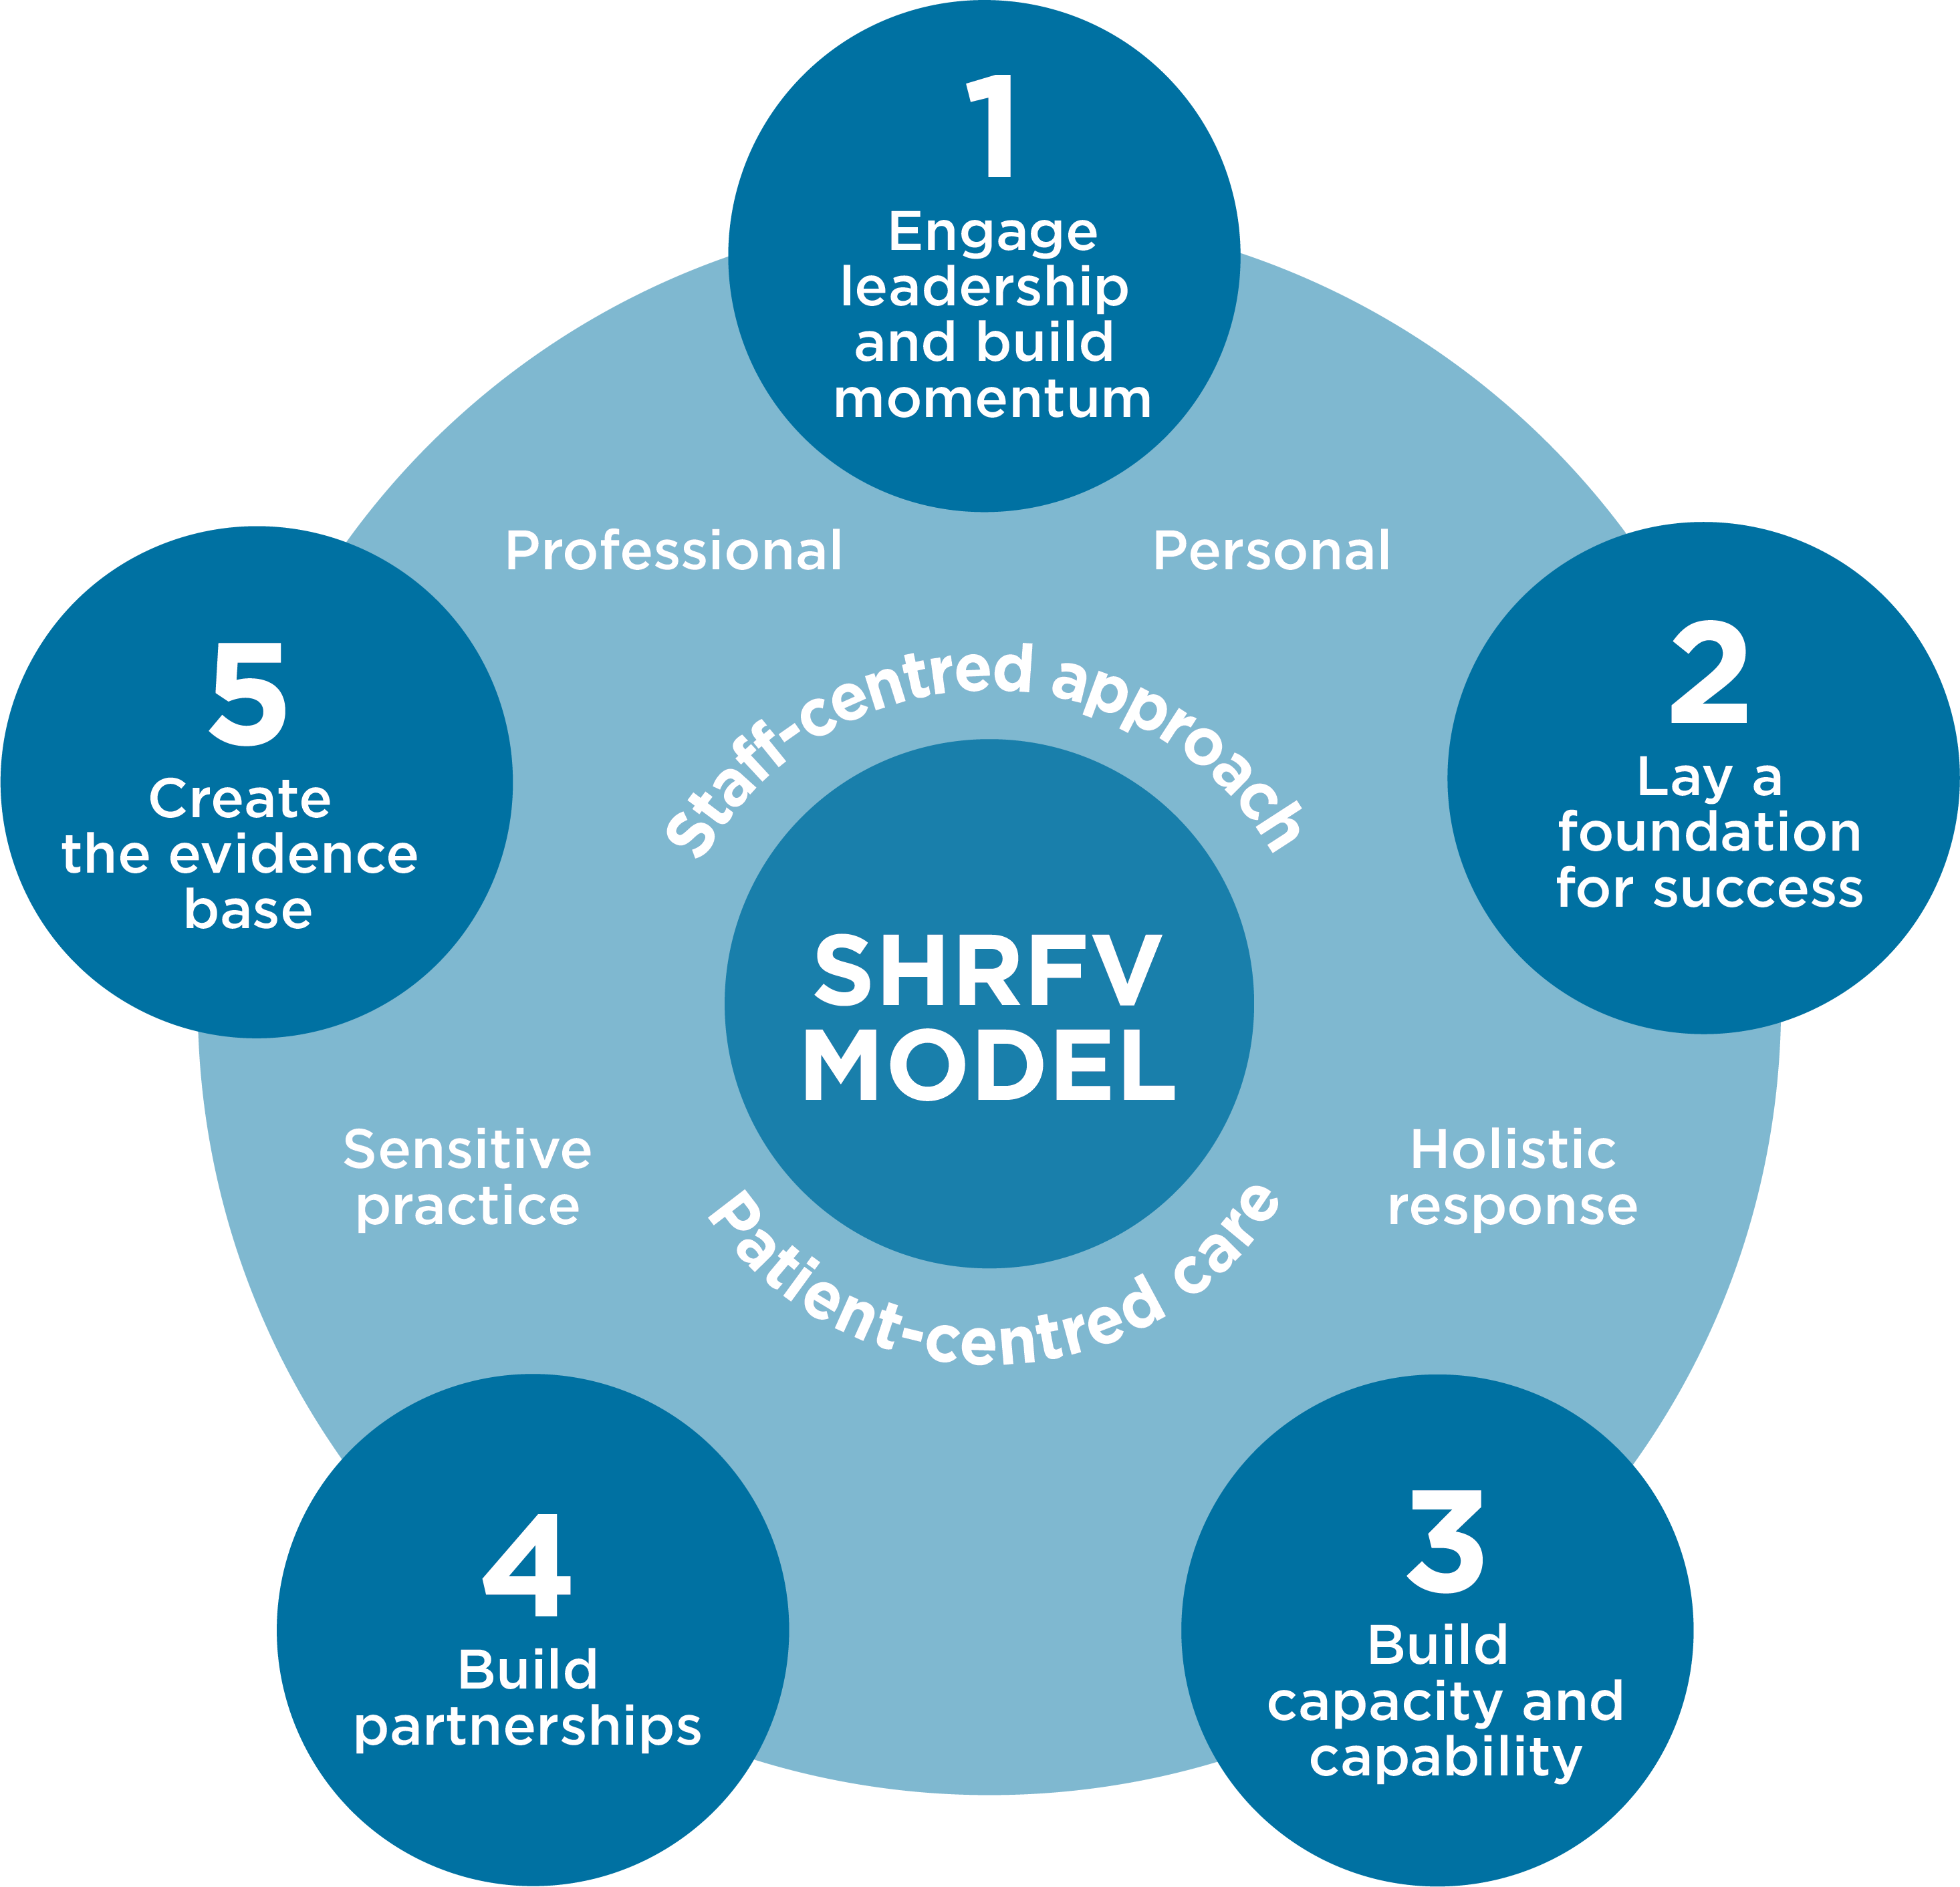
Shrfv model

Slide 16
Getting started
How will our leadership demonstrate its commitment to strengthening our response to family violence?
  Family violence position statement
  Announce SHRFV involvement and what that means for staff and patients
  Improve and promote workplace support for staff personally affected
  Allocate resources to SHRFV training
  Participate in the SHRFV reference group
  Identify potential partners to help change culture and improve response
  Engage champions across the hospital

