Slide 1



Strengthening Hospital Responses to Family Violence
Workplace Support training for Managers – 2.5 hours
Notes:
Welcome and Introduction of trainers
Do pre-session evaluation if required

Slide 2

Notes:
Acknowledgement of Country;
We would like to acknowledge the traditional owners of the lands on which we are meeting today and pay our respect to Elders past, present and emerging.
Name land from which are you presenting and if online ask people to do the same in the chat.
Acknowledgement of victim/survivors of family violence:
We would also like to acknowledge and pay respects to the many victim/survivors of family violence and thank them for sharing their stories with us. Without their courage to share their stories, this work would not be possible.
To victim survivors that may be joining us today, we do hope what we discuss is empathetic and respectful to your experiences.

Slide 3
Housekeeping and group rules
No-one knows everything – together we know a lot!
Right to be inarticulate
Be aware of time - we might need to keep moving
Confidentiality in the training room for you and your staff
If online: Please keep microphones off
Please use chat room for tech difficulties during the session
Please maintain privacy and be aware of who can listen in, especially children.
3
Notes:
HOUSEKEEPING
Face to face
Length of the session - session plan to be on tables
Location of bathroom facilities
Emergency evacuation information
Use of mobile phones – acknowledge that there may be an urgent issue that participants need to attend to in which case they are invited to step out of the room to address this. As per usual, mobile phones should be switched off or on silent.
Group agreements (see page 17 of SHRFV Training Manual)
No-one knows everything – together we know a lot!
Right to be inarticulate
Be aware of time - we might need to keep moving.
Confidentiality in the training room for you and your staff
Story-sharing – participants can share stories that are de-identified. Please be mindful to not share too much detail so that other participants cannot connect the story to the victim survivor. This is not a place to share personal stories and not a therapeutic space.
Nature of the content - Also please be mindful of who might also be able to hear and see this content as many of you will not be in a closed office. It is not appropriate subject matter for children to overhear or view so please be mindful if you have children at home.
If you feel you need to discontinue at any time, you may do so, but we encourage to reach out to available supports.
HOUSEKEEPING - if online.
Videos on or off depending on size and how session is run. Generally off until times when participation is required.
This session is unfortunately not interactive in the same way that a face to face training would be – let know how will be interactive perhaps break out rooms for practice if a small group).
Explain the purpose of the ‘chat room’ if you will be using it. E.g.,
[Name] will monitor the ‘chat’ room for technical issues during the session Please save questions about content and practice till the last few minutes and then type them into the chat. We will try to get through as many as possible. If time we will also come back together via video for questions.
We have provided numbers on the slides for you to follow on the PDF if the video does not work for you, for example if you have phoned in.
If you name is not coming up in the list of participants (you may be on a work laptop with just a number) please say hi with your name in the chat so we can know you have attended.
NOTE: 1800RESPECT and other services information are on the next slide

Slide 4









Specialist Family Violence Services
1800 737 732
1800 015 188
1800 806 292
1800 105 303
1800 755 988
LGBTQIA+
1300 766 491
1800 542 847
1800 729 367
1300 78 99 78
Notes:
Today we will be discussing family and sexual violence.
This topic can be distressing, particularly for people who have been impacted by violence.
If the discussion today causes you any concern for yourself or a colleague or family member or friend, please contact one of these services for support. These are listed in your notes as well as local and workplace services you can access.
1800RESPECT and Safe Steps are 24 hour SACL is an after hours service.

Slide 5

Participant introductions
Notes:
If face to face or small group online - Participant introduction
Break into groups: Ask participants to self-introduce – name & role only.
If large online group: Ask to change name (if incorrect), through participant function,
In chat ask them to introduce themselves, add pronouns and traditional land on they you are calling from.
Reiterate that everyone is welcome and there will be a chat at the end.
.

Slide 6
Learning Outcomes
By the end of the session you will understand:
What family violence is, including its impact in the workplace
How gender inequality drives/causes family violence and the importance of a positive workplace culture
How to recognise indicators of family violence
The importance of prioritising safety and how to make a sensitive inquiry
Your role in supporting staff who are victims of family violence
What workplace supports are in place, such as leave and safety planning.
Pause (k)
Notes:
This training is specifically about how you can safely support staff who are experiencing family violence. it is not about responding to patients. Much of the theory and practice is the same, but policies and procedures differ.
Staff are currently not in scope for Family Violence Information Sharing, so this training does not talk specifically about this legislation nor outline managers' responsibilities under MARAM. If there is a change in this situation, we will update Managers training to reflect this and you will be notified by the hospital through the usual channels.

Slide 7
Defining family violence
The Family Violence Protection Act 2008 defines family violence as:
Behaviour towards a family member if that behaviour is:
  physically or sexually abusive
  emotionally or psychologically abusive
  is economically abusive
  is threatening
  is coercive or in any other way controls or dominates the family member and causes that family member to feel fear for the safety or well-being of that family member or another person; or
  Behaviour by a person that causes a child to hear or witness or otherwise be exposed to the effects of behaviour described above.
Notes:
If face to face (or interactive online session), ask,
What differentiates family violence from normal relationship conflict?
Answer: Family violence is distinguished by the use of coercive control causing victims to feel fear. Family violence also takes many forms, not just physical and not just an argument.
Give the participants a moment to read slide
This is the definition used in Workplace Support which comes from the Family Violence Protection Act Vic
It can be any one of these behaviours. It is not just physical violence
The key words in the definition are ‘control’ and ‘fear’. This is what differentiates family violence from relationship conflict – it is the use of fear to ensure that one person retains power and control within the relationship.
Not all types of violence are criminal offences, e.g. emotional abuse
KEY MESSAGE: Family violence causes fear by exerting power and control
NOTE WE WILL talk more about the signs and indicators later

Slide 8

Gender diversity
Notes:
Recognise gender diversity and why we use the terminology of women and men
We acknowledge that violence is experienced by people whose life and/or identity does not conform to binary definitions of sex and gender.
The definition of ‘women’ used throughout this presentation includes anyone who identifies and lives as a woman. However, in order to reflect and respond to what existing research and data tells us about the key drivers of violence against women at the population level, we use binary terms like ‘men/ women’ and ‘male/female’.
Key Message: It is important to recognise gender diversity and why we use the terminology of women and men

Slide 9
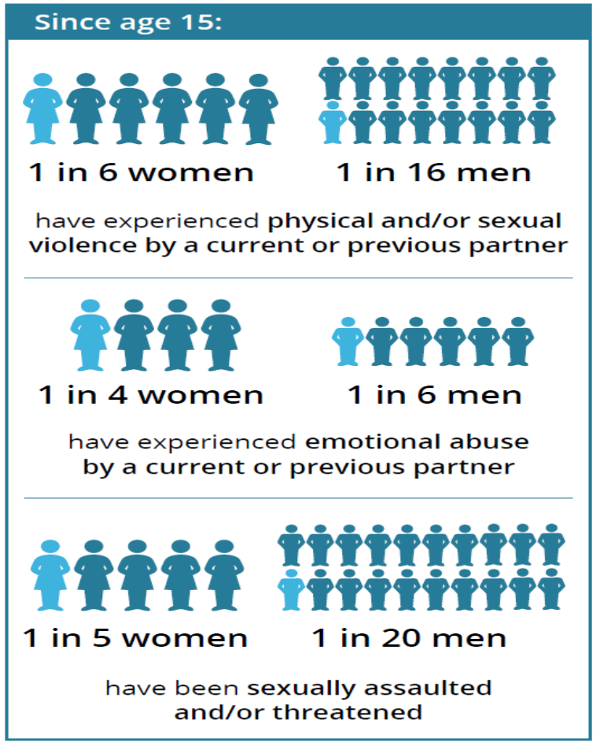
Prevalence & the gendered nature of family & sexual violence
Australian Institute of Health and Welfare. (2018). Family, domestic and sexual violence in Australia 2018 Canberra: AIHW.
Notes:
If face to face (or interactive online session) ask,
Is family violence likely to be experienced in the same way by all people?
If small group, then allow a couple of people to answer and discuss.
Answer: No, there are gendered differences, and some women are more likely to be targeted for violence and face more barriers to accessing help.
This info graphic illustrates the gendered nature of family violence – facilitator is to step through the various infographic data.
Note the high rates of violence experienced by women and men by partners or ex partners, and also high rates of both physical and emotional violence
Family violence is a gendered issue. Overwhelmingly, the majority of acts of family violence and sexual assault are perpetrated by men against women and their children.
KEY MESSAGES:
Victims of family violence are mostly women and children.
Many people are affected by family violence, and they are our patients and our colleagues.

Slide 10
Men are more likely to experience violence:
Women are more likely to experience violence:
From another male
At the hands of a stranger
In a public place
From a male
At the hands of a current/former partner
In a private place
Women’s experiences of intimate partner violence:
More serious violence
Higher risk of serious injury and lethality
More likely to experience fear or anxiety as a result of emotional violence
Notes:
NB: Slide is animated
Family violence is a gendered issue. Overwhelmingly, the majority of acts of family violence and sexual assault are perpetrated by men against women and their children.
Men and women have different experiences of violence, with men experiencing more violence than women.
Victims of family violence are predominantly women and children, males can also be victims, particularly as children.
Women are much more likely to be living with this violence and fear over weeks, months, years, and lifetimes, so this is likely to have even more of an impact on their health and wellbeing
Men’s experience of violence:
“What about men’s experience of violence?” We acknowledge that all violence is wrong regardless of the sex of the victim or perpetrator. But there are distinct patterns in the perpetration and impact of violence that point to the fact that gender is a factor. For example, both men and women are more likely to experience violence at the hands of a man, with about 95% of all victims in Australia reporting the perpetrator as a male.
However, the ABS survey shows that men are most at risk of violence outside of the home perpetrated by a stranger or neighbour while women are most at risk of violence within their home from a man they know.
Recognising the gendered patterns of violence doesn’t negate the experiences of male victims but it does point to the need for an approach that looks honestly at what the research tells us.
Acknowledging the gendered nature of family violence is not to demonise men or to make them feel bad about themselves. Most violence is committed by men but this does not mean that most men are violent. However, until we acknowledge the source of the issue, we will not be able to address the problem.
KEY MESSAGE: is all violence is wrong

Slide 11
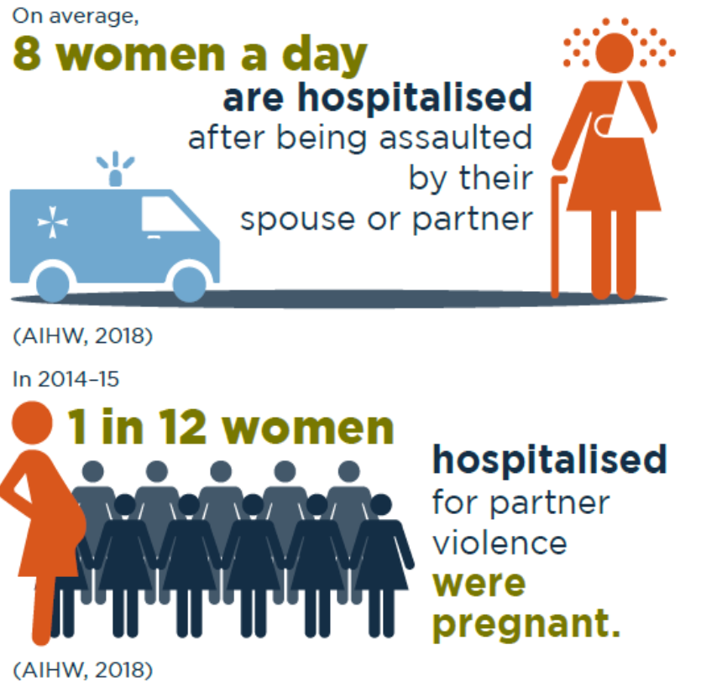
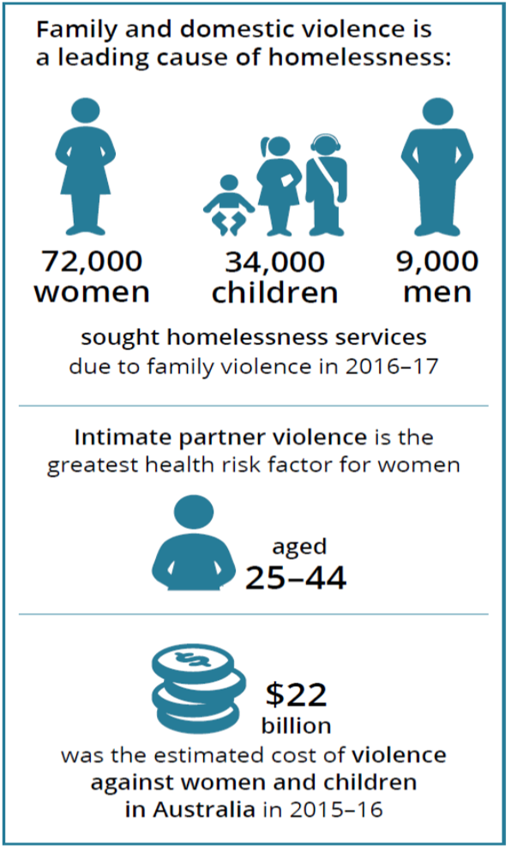
Family violence is a health and welfare issue
Notes:
Family violence has severe and persistent impacts on a person’s physical, psychological and social wellbeing and is the leading cause of homelessness
In 2016-2017, there were 1,328 people who presented to Victorian hospital emergency departments with a family violence related injury and of those 40% had sustained a brain injury (Brain Injury Australia, 2018)
Women who experience family violence rate their health as poorer and use health services more frequently than other women
The psychological impacts of family violence - such as depression, anxiety, and post traumatic stress disorder - are profound and endure long after the violence has stopped
The social, behavioural, cognitive and emotional effects on children are significant and may have a lasting impact on their education and employment outcomes
Key message: Family violence is a health issue with severe and persistent impacts on a person’s physical, psychological and social wellbeing

Slide 12
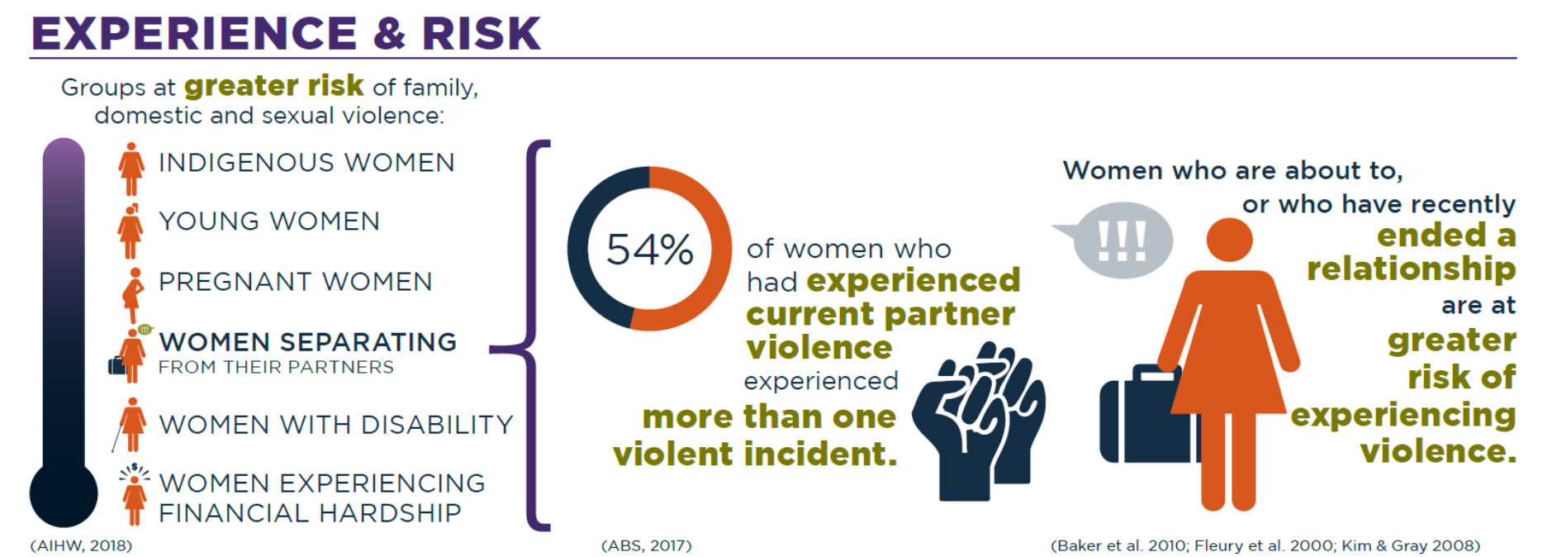
Groups at greater risk of family violence
Notes:
In addition to family violence being gendered, there are certain groups of people in Australia who are more likely to experience family or sexual violence than other groups, or who face additional barriers in coping with and recovering from family, domestic and sexual violence.
Research has shown that women who are about to or have recently separated from their partners are at a greater risk of experiencing violence and a high number of deaths and near fatal assaults occur three to six months post-separation. This is why we need to challenge the long held misconception that a woman ‘can just leave’ an abusive relationship, it may simply not be safe for her to do so.
These groups (above) do not experience more violence because of their identity, but rather because of the structural inequality and discrimination they experience. Community attitudes that normalise, tolerate and excuse increased rates of violence towards these communities along with services not being as accessible to these groups, creates opportunities for perpetrators to target these groups.
Key message: There are a number of factors that when they intersect with gender can greatly increase the risk of family violence.

Slide 13
Compared with non-Indigenous Australians, Indigenous Australians
experience:
Compared with non-Indigenous Australians, Indigenous Australians
experience:
Notes:
Family violence is not part of Aboriginal culture. However, Aboriginal women are disproportionately impacted by family violence due to the structural inequalities and discrimination they experience underpinned by racist and sexist attitudes and the on-going impacts of colonisation.
Violence towards Aboriginal people is often perpetrated by non-indigenous men. It is important that our hospitals are safe spaces for Aboriginal staff members to disclose and seek support.
It is racist attitudes, practices and structures that mean that an Aboriginal women who discloses family violence is often ignored and not offered assistance. Racism also translates into structures that make it difficult for Aboriginal victims to get help even though they are at greater risk. The ongoing cuts to Aboriginal family violence services is an example of that.
Key message: Racism drives the high rates of violence against Aboriginal women and children

Slide 14
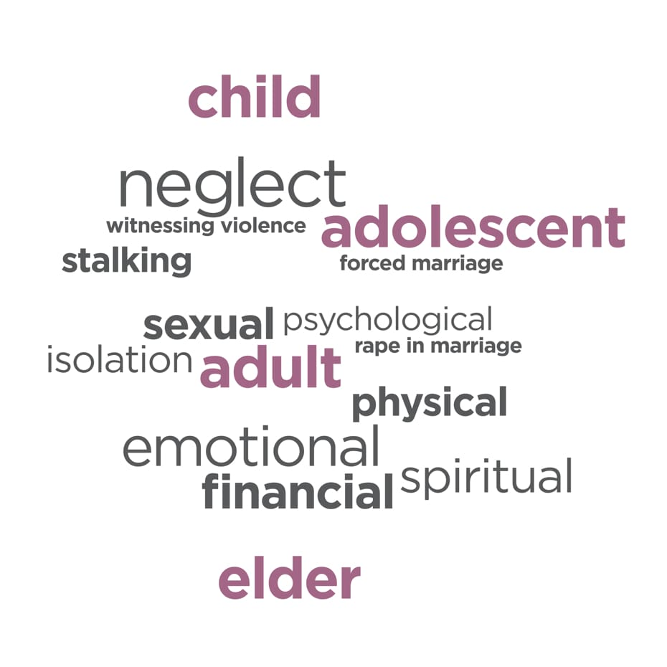
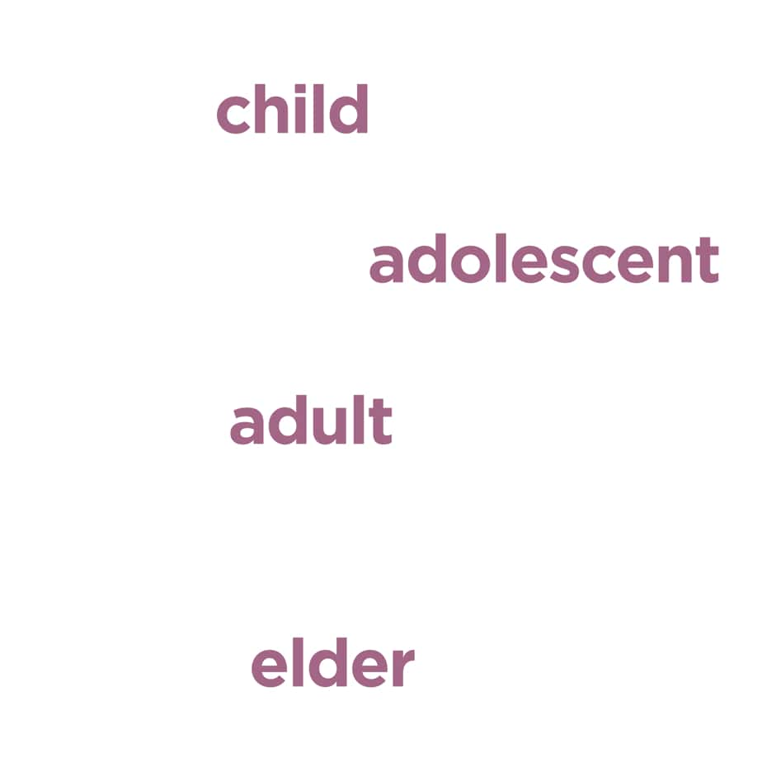
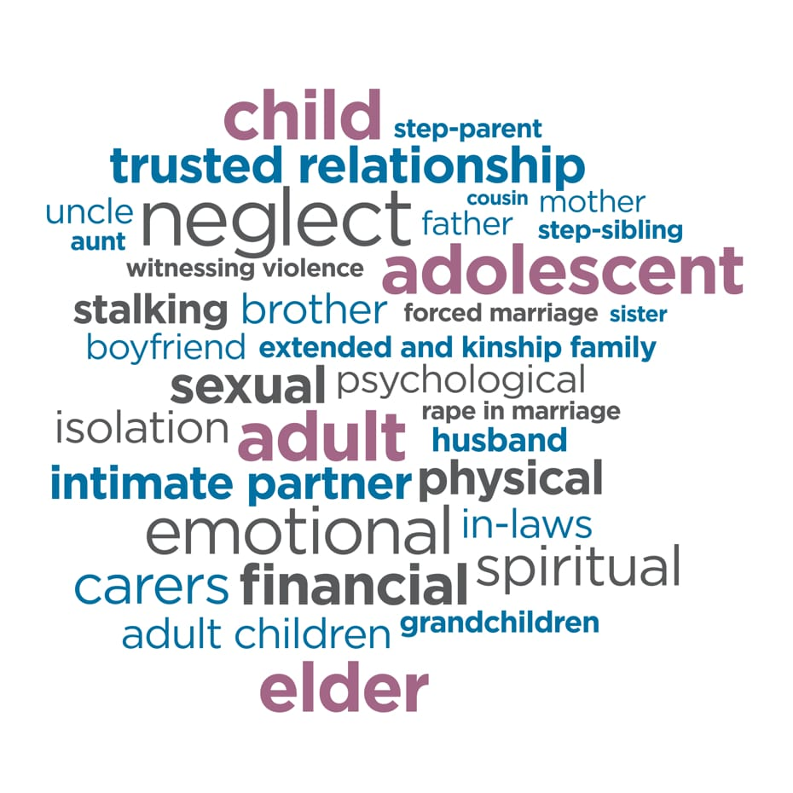
Family violence is complex
It occurs throughout the lifespan.
There are many types of abuse.
And many different perpetrators.
Notes:
We have spoken a bit about family violence and in particular about violence between partners or ex partners.
What we know is that family violence is complex, it occurs throughout the lifespan (pink)– it affects girls and boys, women and men
There are many types of abuse (black) – all are a fundamental violation of human rights and unacceptable.
And many different perpetrators (blue) – not all are men
Family violence occurs in all kinds of families, and in family relationships extending beyond intimate partners, parents, siblings, and blood relatives. It includes violence perpetrated by older relatives, by younger family members, or against a same-sex partner, or from a carer towards the person they are looking after.
Family violence occurs within the LGBTIQA+ community with a similar prevalence rate as the non LGBTIQA+ community.
Psychological trauma is commonly experienced by people affected by family violence – from both current and past experiences.
KEY MESSAGE: Family violence is common, complex and will be affecting our staff.

Slide 15


Gender inequality sets the context for violence
Our Watch, Let’s change the story: Violence against women and children in Australia (Our Watch)
Notes:
NOTE THIS SLIDE IS ANIMATED - It shows the covers of change the story and changing the picture
To understand the high rates of family violence, especially against women and children, it is important to understand what causes or drives family violence. There are currently two Australian frameworks can help us understand this.
Click for first image
The first is Change the Story which looks at the drivers of violence at a population level, and
Click to next image
And the second is Changing the Picture which explains the extremely high rates of violence against Aboriginal and Torres Strait Islander women and children due to ongoing colonisation and racism across society, in attitudes, structures, practices and systems.
It identifies the ongoing impacts and legacies of colonisation as a key driver of the disproportionate rates and impacts of violence against Aboriginal and Torres Strait Islander women and their children.
The way we understand the high rates of violence against Aboriginal and Torres Strait Islander women goes back to our colonial past, and the fact that the process of colonisation is violent, brought a particular gendered society to Australia (brought a way of thinking about how men and women should think and act) and that this process of colonisation is ongoing
Changing the Picture also describes the actions we can take to end violence against Aboriginal and Torres Strait Islander women and the principles that underpin this work
Both these frameworks also suggest actions we can take in the workplace and in health care setting to prevent violence.
Click to next slide to play video

Slide 16

Gender inequality sets the context for violence
Our Watch, Let’s change the story: Violence against women and children in Australia (Our Watch)
Notes:
We will now take a moment to look at the Change the story video
Show video (4.28)
The video talks about the four gendered drivers of violence one being rigid gender stereotypes that dictate how society expects men and women and girls and boys to behave.
This stereotyping translates into what roles and jobs society deems is acceptable for men and women to hold and also what value it put son those roles, and so how much people are paid in different jobs
The outcome of this women on the whole, being paid less, having less superannuation and less choice and decision making power both in family relationships and more broadly in society.
It has also translated into violence against women not being viewed as a serious health and welfare issue.
In sum, the less power and value you have in society the more you are likely to be targeted for violence. And whilst there have been gains particularly in the last few years, women are still not treated equally and with respect as is evident in the statistics.
Gender inequality is a driver and a result of violence against women. For example a woman who has to leave a family violence may have to move to another location, find new housing, schools and employment and is very likely to be significantly disadvantaged financially
As noted before, certain groups of women are more at risk of violence than others and the work we need to do needs to also address other forms of discrimination in addition to sexism.
Change the story does not seek to explain the high rates of violence against those groups who experience higher rates of violence. That work is ongoing.
Key message: As a society we need to promote respectful relationships and work to advance gender equality if we are to prevent men’s violence against women

Slide 17

Gendered inequality in the workplace
Not believing victims.
Policies that don’t send a clear message that violence is not ok
Condoning, excusing of violence including victim blaming
Stereotypes of men as leaders or decision makers & women only in caring roles
Strongly held gender stereotypes
(for men & women)
Workplace examples
Gender pay gap.
Women having less representation in executive positions
Workplace culture that is sexist.
Workplace sexual harassment & bullying
Men controlling
decision making
Women having less power
& independence
Disrespect to women by men, particularly when they are in groups.
Notes:
NOTE THIS SLIDE IS ANIMATED - The four gendered drivers appear first.
What the evidence tells us is that the four gendered drivers are at play across society including in the workplace as these examples show.
Click through and read examples
Note that there are changes happening, but slowly and we still have a long way to go. We may hear that women have achieved gender equality, but the reality is that there is still inequity in almost all areas of life.
KEY MESSAGE: Gender inequality is the driver and consequence of violence against women

Slide 18

      From CHANGE THE STORY: A Shared Framework for The Primary prevention of Violence Against Women and Their Children in Australia www.ourwatch.org.au
Notes:
The good news is that there is hope and the is change afoot. We have multiple opportunities through our interactions with colleagues at work to prevent as well as respond to family violence.
The work that your hospital / health service is doing as part of SHRFV challenges the condoning of violence against women through raising awareness of it, and structurally through supporting victim/survivors to access help, remain at work and maintain independence. The work to build respectful relationships at work also contributes to ending family violence.
Key Message: We can prevent violence if we all work together

Slide 19
The workplace as a setting for prevention
Workplace Support (family violence support)
Respectful
Workplace
Behaviours
(bullying & harassment)
Prevention of family violence
Gender Equality in values & strategy
Notes:
We often get to this part of the training and are asked, “so, what can we do to prevent this violence and whose role is it?”
There are many actions we can take to prevent family violence, both as individuals and workplaces. This work is already happening in our hospitals, with actions to build respectful workplace behaviours and to through the work to promote gender equality.
Today we are focused on the work to support staff who may be experiencing family violence which is also a crucial part of this work. The Family Violence Workplace Support Program is our program for responding to staff experiencing family violence.
Before we move into looking more closely at Workplace Support, we will take a moment to look at the workplace as a site of prevention of violence, and what this looks like.
Workplace is an important site for prevention of violence against women, that is, challenging gender inequality. This work is now legislated through the Gender Equality Act 2020, which covers all Victorian public health services.
Evidence suggests that stopping the violence before it begins will have the greatest impact on the prevalence of family violence.
In the workplace, we have an opportunity to contribute to a culture that challenges gender inequality and rigid gender stereotypes and to create an environment where gender equity is valued by promoting equal and respectful relationships between women and men.
As a manager, you are in a leadership role and it is the expectation that you will actively contribute to a culture that is respectful, promotes respectful relationships between women and men and enshrine gender equity measures.
Let’s take a look at a video that explains what this means.
KEY MESSAGES:
The workplace can contribute to the prevention of family violence through ensuring its culture is respectful and promoting gender equity measures
Supporting our people affected by family violence is the right thing to do

Slide 20
Your role as manager
  Understand the gendered nature, prevalence and seriousness of family violence
Facilitate an accessible, culturally responsive environment for safe disclosure of information and engagement, including for Aboriginal staff and those from diverse communities
  Identify family violence risk and respond appropriately, recognising and addressing barriers to support and safety
  Use a person-centred approach, recognising that victim survivors are usually the best judge of their own safety
  Be familiar with the Workplace Support program, including leave entitlements & knowing how to support staff to be safe at work
  Safely record and store staff family violence information as per hospital procedure.
Notes:
Talk briefly to each point above and then and cover the points below
Everyone’s role is vital in an effective response to family violence
You have a specific role as a manager within the workplace
This slide covers what your role is. This is also outlined in the WS procedure
Note that if a clinical manager their role may have additional responsibilities in relation to patients.
The current FV Information Sharing Scheme does not cover staff, only service users /patients
KEY MESSAGE: Its important to know your role and limitations: You are not expected to be an expert in family violence.

Slide 21
How does family violence impact the workplace?
Negative workplace impacts of FV on victims
  Disrupted work
  Decreased productivity
  Impaired capacity to work
  Absenteeism
  Resignation or being fired
  Being at work and having a job can be a protective factor providing income, safety and support to victims.
  McFerran, L. (2011) Safe at Home, Safe at Work?
Notes:
Family violence can impact the victim survivor and others in the workplace in many ways. There are many negative impacts of family violence on victim survivors that you may see at work. including:
Disrupted work, decreased productivity, absenteeism (high sick leave rates) resignation and a real fear of losing the job due to these productivity factors.
Much of what we know comes from a study out of NSW, which reported the main impact was on work performance, with 16% of victims reporting being distracted, tired or unwell, 10% needing to take time off, and 7% being late for work (McFerran, 2011).
As many victims report losing their job as a result of family violence and many victims will not disclose for fear of losing their jobs, our role is to be clear that rather than punish a victim survivor for coming forward, we will provide that staff member with the time and capacity to respond to their safety and wellbeing needs.
Employment for the victim survivor is one of the most important protective factors, as it contributes to financial independence, and provides social support.
The first study investigating family violence among female healthcare workers in Australia has found that almost half of them (45 per cent) have experienced family violence, including one in nine who had experienced abuse and violence by a partner during the previous 12 months.
The study, involving 471 Victorian female healthcare workers, found that one in eight women had been sexually assaulted by a partner since the age of 16.
KEY MESSAGES:
Paid employment is an important protective factor for people affected by family violence
Work colleagues and managers are important sources of support

Slide 22
Disclosure and help seeking in the workplace
  Work colleagues are common sources of support (primarily co-worker)
  About half disclosed the violence to their manager/supervisor, though only 10% found them helpful
  For those who hadn’t discussed it, reasons were privacy, shame and fear of dismissal
  Rarely were workplaces included in legal protection orders
  McFerran, L. (2011) Safe at Home, Safe at Work?
Notes:
So, what do we know about disclosure and help seeking in the workplace?
Read out slide.
Its important that build a safe space for staff who are victims of family violence to disclose and receive appropriate support.
Note on first dot point: 45% of respondents with recent experience of domestic violence discussed the violence with someone at work, primarily co-workers or friends rather than supervisors, HR staff or union representative.
It is notable that 95% of women with violent stalking partners, were harassed in their workplaces. But rarely are workplaces named in intervention orders. Logan T, Shannon L, Cole J & Swanberg J 2007, Partner stalking and implications for women’s employment, Journal of Interpersonal Violence, vol. 22, issue 3, pp. 268-291
“It happens to clinicians too”: an Australian prevalence study of intimate partner and family violence against health professionals; This study suggests that intimate partner and family violence, including sexual assault, are frequent traumas in the lives of participating women health professionals. One in ten (11.5%) health professionals had felt fear of their partner, or experienced physical, emotional and/or sexual violence from them during the previous 12 months. The University of Melbourne 2018.
KEY MESSAGE: Work colleagues and managers are important sources of support
High rate of FV amongst health workers. McLindon - Mon to add.

Slide 23
Sensitive practice
Sensitive practice involves:
Noticing signs that may indicate family violence is occurring
Confirming this by undertaking sensitive inquiry, considering a person’s self-assessed level of risk, safety and fear
Responding appropriately, recognising and addressing barriers to support and safety
Offering information about, and referral to, appropriate family violence specialists and the Workplace Support program in the hospital.
Notes:
Note that for the rest of the session we will be going through these steps in detail.

Slide 24
Being culturally safe, accessible & inclusive
When talking to a staff member:
Be mindful of your own biases and how they may influence your judgements and assumptions about a person’s experience of family violence or assessment of their risk
Be mindful to not reinforce stigma, stereotypes of discrimination by respecting their culture and identity
Tailor your response to their identity and needs
Hear and acknowledge how workplace and service systems place barriers on their access to support, and take steps to remove identified barriers
Recognise a victim survivor as the expert in their own experience and do not make decisions for them.
Offer support not advice.
Notes:
All staff are responsible for facilitating an appropriate, accessible & culturally safe workplace environment which ensures staff feel & are safe to make a disclosure of family violence, will receive a response that is respectful and sensitive, meets their needs and ensures they can access the right support.
Be mindful of your own biases and how they may influence your judgements and assumptions about a person’s experience of family violence or assessment of their risk
Be mindful to not reinforce stigma, stereotypes of discrimination by respecting their culture and identity
We can do this by continuing to develop own knowledge about identities, barriers and experiences of family violence across the community
Tailor your response to their identity and needs
For example, consider if mainstream referral may be more appropriate rather than a culturally specific service. In smaller communities, the victim survivor may have concerns around privacy or perpetrator finding out.
Hear and acknowledge how workplace and service systems place barriers on their access to support, and take steps to remove identified barriers
upholding everyone’s right to receive a culturally safe and respectful service may involve advocating for changes to practices and structures internally and externally
recognise a victim survivor as the expert in their own experience and do not make decisions. Offer support not advice.
This includes respecting an individual’s right to self-determination.
Ensure any action taken are victim led; and that they have access to information and support from specialist services.
Key Messages: We need to put effort into ensuring we provide a culturally safe, accessible and inclusive response. This is partly looking at our practices and systems and also looking at our own attitudes.

Slide 25
Common Myths
Why doesn’t she just leave?
There is no power imbalance in same sex relationships
He’s a good dad and the kids don’t see it, so it doesn’t hurt them
Its just part of their culture
She wasn’t wearing much
She pushed him to it
Excusing
They’re just a volatile couple
Justifying
It only happens in poor, uneducated families
He was just drunk or stressed or….
Minimising
Notes:
Note that the slide is animated.
One of the things that is common in the unhelpful responses is the judgement and preconceptions about family violence, victims and perpetrators that we all hold become part of the response. We need to be mindful of these myths and not and not respond with them or let them inform how we respond.
One such myth is that ‘women can easily leave’. If we think this we are not validating their experience and block us from supporting them emotionally, and assisting them to make informed choices.
Note that they are things we may have heard at work, on TV or even at our own kitchen table.
Click to next part
Note that these mainly focus on what the person experiencing family violence does not do rather than questioning perpetrator behaviour – they excuse, justify, minimise or blame the victim
We all have our own unconscious biases, our beliefs and values about violence and women have come from our family, culture and a life time of experiences. This will influence how we understand family violence and respond to disclosures from both victims and perpetrators.
As managers we need to be aware of what our reaction to someone story is. Have we immediately put blame back on the victim, disbelieved her because of how she looks or speaks, and then we need to ask whether our beliefs are stopping us responding in a safe, non-judgemental and supportive manner.
Explain that we don’t have time to unpack them all, but there is plenty of resources for you to explore your own beliefs and also to find out the facts.
KEY MESSAGE: Myths excuse, justify and minimise family violence. Respectful workplace culture is essential to support non-violent norms and practices.

Slide 26
Notice workplace Indicators / signs of family violence
  Physical Injuries / pain
  Anxiety/depression
  Recently separated or divorced
  Difficulty making decisions
  Fearful/ Guarded
  Partner checking up/always present
  Frequent absences
  Loss of concentration
  Inability to find money for basics
  Disruption to home life, homelessness
  Constant checking of phone
  McFerran, L. (2011) Safe at Home, Safe at Work?
Notes:
It is important to be aware of possible indicators of family violence in the workplace so that if they are present you can decide if it is appropriate to talk with your staff member about family violence.
It is important to note that the presence if these indicators does not necessarily suggest the presence of family violence, but it may prompt you to inquire.
It is not your role as a manager to screen for family violence, by asking team members routinely. However, if these indicators are present it may mean that family violence is present which in turn may lead to sensitive enquiry.
KEY MESSAGE: Be aware of behaviours that could point to family violence.

Slide 27
Evidence based risk factors
There are a number of evidence based factors that point to a higher risk to the victim, including certain perpetrator behaviours, injuries and types of violence and specific circumstances.
Two risk factors of note for managers are:
  when a women is planning to leave or has just left a relationship, and
  pregnancy and following a new birth.
You can consult a specialist family violence service for more information about these risk factors if you are concerned about what you may see or hear.
Notes:
Two key factors where women are at high risk and which you may be aware of as a manager are firstly when a women is planning to leave or has just left a relationship and secondly pregnancy or child dangerous time is pregnancy and following a new birth. You may be aware of these as a manager or colleague
It is not your role to ask about these risk factors. That is the role of family violence specialist but it is your role to be aware if you hear about something that you.
KEY MESSAGE: Be aware of signs or behaviours that could point to family violence.

Slide 28
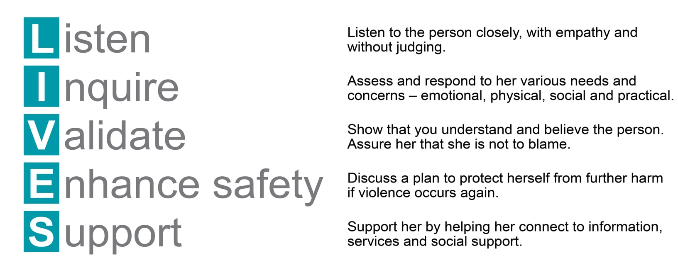

Ask sensitively and respond respectfully
LIVES is an approach to engaging in a way that increases or elicits feelings of safety, respect and control.
Notes:
So how do we support a staff member who is experiencing family violence? We use a technique called sensitive inquiry which relies on observation of signs and risk factors that may indicate family violence is occurring, and then confirming this by undertaking the identification questions.
Sensitive practice involves understanding that victim survivors are often are the best judge of their own risk. But also that they may not always be aware of the risk factors.
It is your role as managers to understand family violence, be aware of the risk factors and indicators above and then to make a sensitive inquiry if there are indicators.
It is not intended that you take on the role of a Family Violence specialist. Instead we are providing a pathway to support – which is directed by the victim.
The goal of inquiry is not disclosure, although a disclosure may come about as a result of sensitive enquiry. The goal of sensitive inquiry is to provide support and validation. You may need to say this several times during training to make sure this message is understood
How managers respond is crucial to eliciting feelings of safety, respect and control for the staff member and it can make a big difference.
LIVES is a World Health Organisation model – it is a way of reminding us how best to respond. LIVES is a first-line support that involves five simple tasks. It responds to both emotional and practical needs at the same time.
LISTEN: being listened to can be an empowering experience for a person who has been abused. Listen with eyes, ears and heart - with empathy and without judging. ‘That must have been very frightening / difficult for you.’
INQUIRE ABOUT NEEDS AND CONCERNS: assess and respond to her various needs and concerns—emotional, physical, social and practical (e.g. childcare)
VALIDATE: show her that you understand and believe her. Assure her that she is not to blame. ‘Violence is unacceptable, and you do not deserve to be treated this way.’
ENHANCE SAFETY: ask what the person’s immediate concerns are. ‘Are you concerned about your safety or the safety of your children or pets?’ Assist them to seek help from a more specialised service.
SUPPORT: provide support by helping to connect to information, services and social support. ‘Would you like some support to help you deal with the situation?’
KEY MESSAGE: We should approach our staff in the same way as we approach our patients – sensitively.
The sensitive inquiry process relies on the elements of structured professional judgement to ascertain if family violence is occurring and the staff members’ level of risk

Slide 29
Power and control
As a manager you are already in a position of power in relation to your staff members.
Family violence occurs in the context where power is used to control and dominate another person and causes that person to fear for the safety of well-being of themselves or another person.
Therefore any action that replicates this pattern could potentially:
Increase the staff member’s sense of disempowerment
Decrease their sense of safety at work
Continue to reinforce and normalise controlling/dominating behaviour
Notes:
We have talked about what a sensitive inquiry is, and we will in a moment go through how this looks in practice. Before we do, we do want to make a note about power and control in the manager, staff relationship.
Managers are in a position of power in relation to the staff that they manager. This is part of the authority a manager has in the exercise of their duties.
However, in a discussion with a staff member about family violence we must be mindful of the positional power that exists and conduct ourselves in a way where that power is not used to control and dominate. This is important so as to not replicate the experience of the loss of power and control for the staff member.
As we now move into a role play, be aware of the existence of power within the relationship.
KEY MESSAGE: Be mindful of your position of power in relation to your staff member and do not use that power to control or dominate.

Slide 30
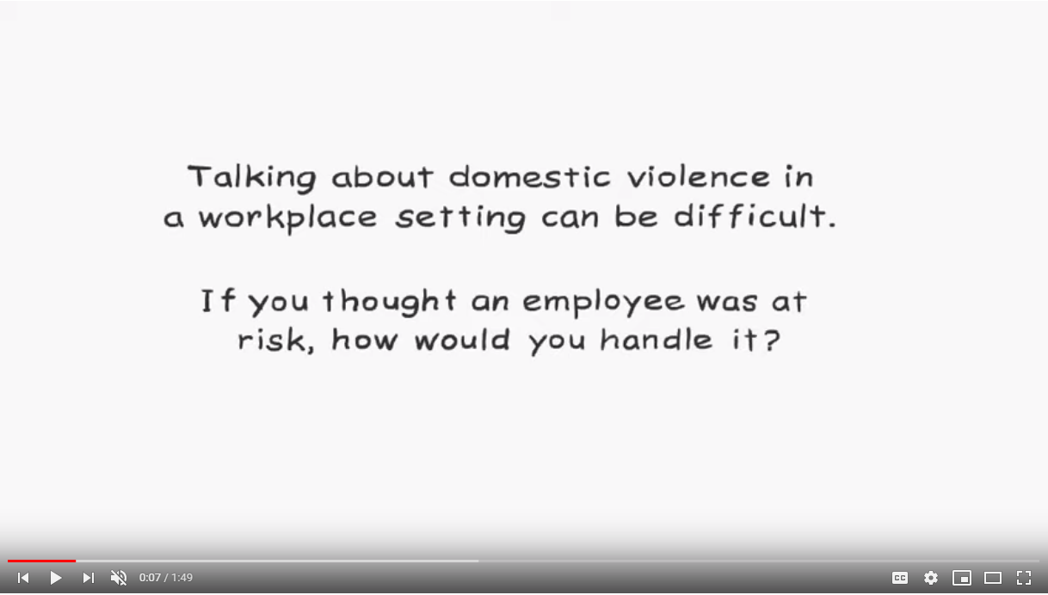
Sensitive Practice in a workplace setting
https://www.youtube.com/watch?v=KeJDtvs1NtQ&feature=youtu.be&list=TLPQMjAwMTIwMjC59AXCS_-srQ
Notes:
Show the video.
If you are on time watch this video
Note: it shows It shows a clear example of safe and supportive practice

Slide 31
Helpful responses Unhelpful responses
I know this must be difficult for you to talk about but I’m worried about your safety and want to support you any way I can.
You and your children deserve to be safe.
It is his choice to use violence.
Would you like some information and support about ways to stay safe?
Whatever you choose to do, we are here to support you.
Why don’t you just leave?
What did you do to make him so angry?
If you really care about your children then you’ll leave him!
Why do you think you keep finding yourself in violent relationships?
It sounds like he has an anger management issue!
What can we can do to help if you choose to stay.
2. Have they controlled your day-to-day activities (e.g. Who you see, where you go) or put you down?
4. Have they hit, slapped, kicked or otherwise physically hurt you?
Notes:
We will give you a minute to look at these helpful and unhelpful responses and think about what makes them helpful or not helpful.
Helpful responses:
Validates and offers support to enhance safety
Include rights-based statements
Assigns accountability to the perpetrator and places control with the victim survivor
Provides support that is unconditional.
Unhelpful responses:
Blames the person experiencing violence
Fails to understand the complexity of the issue
Diminishes perpetrator responsibility and offers support that is conditional on the victim survivor ending the relationship
Key message: A sensitive and non-judgemental response is vital to a staff member feeling safe and supported.

Slide 32
Inquiring about family violence with staff: Opening the discussion
You have told me
(reflect back what you have heard)
Is there something going on outside of work that You would like to talk about? I am here to listen as the welfare of my staff is very important?
You’re such a great member of our team but I’ve noticed lately that you’re not yourself– is there anything outside of work that is causing you stress?
Notes:
Inquiring about family violence with staff
If family violence is disclosed or if indicators of family violence are observed, your role is to sensitively and respectfully open up a conversation.
This procedure is outline in an Appendix in the Workplace Support Procedure.
You are encouraged to ask an employee if they are experiencing family violence, but you are not required to do this.
A relationship of trust with your employee and a supportive environment are important foundations to making sensitive inquiry as comfortable and safe as possible. Be truthful about limits of confidentiality and your duty of care.
It is always good to start with a framing statement
The purpose of a framing statement is to position the inquiry about family violence as a routine part of hospital activities – to normalise it. Use open questions of enquiry – this gives the employee control over how much they choose to respond. They may want to give a little or a lot of information; this is the employee’s choice.
This will make the person feel less ‘singled out’, reducing the stigma associated with being identified as a victim of family violence and/or sexual assault.
You need to frame a statement that works for you so that it is authentic – not too scripted.
Clinicians already ask a lot of uncomfortable questions in clinical practice, this too may take getting used to.
Choose the setting carefully – a private space, a time when the workplace is not so hectic, at what point during the shift is it best to ask, what are the clinical demands of the person, do you have a plan in place if a disclosure is made and the person is too distressed to resume their duties.
Scared of what the person will say and not knowing how to respond – this training will help you know how to respond
Non-verbal information (for example internet, poster or written material) can have a valuable educative impact – make reference to workplace support materials - if someone sees these it can alert them to the fact that they can talk with you or someone at the hospital another time – give them food for thought
KEY MESSAGE: It is important to normalise inquiries about family violence – in the context of our workplace support program

Slide 33
Housekeeping and group rules
No-one knows everything – together we know a lot!
Right to be inarticulate
Be aware of time - we might need to keep moving
Confidentiality in the training room for you and your staff
If online: Please keep microphones off
Please use chat room for tech difficulties during the session
Please maintain privacy and be aware of who can listen in, especially children.
33
Notes:
HOUSEKEEPING
Face to face
Length of the session - session plan to be on tables
Location of bathroom facilities
Emergency evacuation information
Use of mobile phones – acknowledge that there may be an urgent issue that participants need to attend to in which case they are invited to step out of the room to address this. As per usual, mobile phones should be switched off or on silent.
Group agreements (see page 17 of SHRFV Training Manual)
No-one knows everything – together we know a lot!
Right to be inarticulate
Be aware of time - we might need to keep moving.
Confidentiality in the training room for you and your staff
Story-sharing – participants can share stories that are de-identified. Please be mindful to not share too much detail so that other participants cannot connect the story to the victim survivor. This is not a place to share personal stories and not a therapeutic space.
Nature of the content - Also please be mindful of who might also be able to hear and see this content as many of you will not be in a closed office. It is not appropriate subject matter for children to overhear or view so please be mindful if you have children at home.
If you feel you need to discontinue at any time, you may do so, but we encourage to reach out to available supports.
HOUSEKEEPING - if online.
Videos on or off depending on size and how session is run. Generally off until times when participation is required.
This session is unfortunately not interactive in the same way that a face to face training would be – let know how will be interactive perhaps break out rooms for practice if a small group).
Explain the purpose of the ‘chat room’ if you will be using it. E.g.,
[Name] will monitor the ‘chat’ room for technical issues during the session Please save questions about content and practice till the last few minutes and then type them into the chat. We will try to get through as many as possible. If time we will also come back together via video for questions.
We have provided numbers on the slides for you to follow on the PDF if the video does not work for you, for example if you have phoned in.
If you name is not coming up in the list of participants (you may be on a work laptop with just a number) please say hi with your name in the chat so we can know you have attended.
NOTE: 1800RESPECT and other services information are on the next slide

Slide 34
Identifying whether family violence is occurring
“Has anyone in your family done something that made you feel unsafe or afraid?”
“Have they controlled your day-to-day activities (e.g., who you see, where you go) or put you down?”
“Have they threatened to hurt you in any way?”
“Have they hit, slapped, kicked or otherwise physically hurt you?”
Notes:
So, coming back to when you are making your sensitive inquiry.. Remember we asked, ‘I noticed that you seem to be quite withdrawn from the team and a bit distracted – is everything OK at home?”
If someone isn’t ready to respond to your questions about family violence, you need to respect this and let them know that if they are ready in future to talk about any thing that concerns them, you are open to doing this.
If they indicate that things are not ok at home, inquire about family violence using questions about their safety.
“Has anyone in your family done something that made you or (your children) feel unsafe or afraid?”
Have they controlled your day-to-day activities (e.g. who you see, where you go) or put you down?”
“Have they threatened to hurt you in any way?”
“Have they hit, slapped, kicked or otherwise physically hurt you?”
Again, if responses to your questions indicate that no family violence is occurring, you must respect this. The person might not be ready or not feel comfortable to talk to you about the family violence they are experiencing. They may also not be experiencing family violence. Thank the person for answering the questions and inform them about the help that is available and that they are able to contact you or a family violence service in future should they ever experience family violence.
Let them know about your staff Employee Assistance Program and any other internal services to promote health and wellbeing.
HOWEVER,
If they identify that they do feel unsafe or afraid, ask about their immediate safety;
“Do you have any immediate concerns about your own safety, the safety of your children or someone else in your family?

Slide 35
Respond to family violence risk
“Do you have any immediate concerns about your own safety, the safety of your children or someone else in your family?
Yes
Ask if they require police (000) assistance, check if they wish you to call and it is safe for you to call the police.
Provide them with the numbers and details of specialist family violence services to assist with safety planning and support.
If they are not willing to receive assistance, but children are at risk, Discuss with your manager possible notification to child protection/police (000). You can call a family violence service with de-identified information for advice as well.
Consult with your manger HR and/or a specialist family violence service.
Notes:
In response to the questions
“Do you have any immediate concerns about your own safety, the safety of your children or someone else in your family?
If they say yes, that is If family violence is identified and an immediate risk management response is required (i.e., the person has let you know they are experiencing an immediate threat to their life, health, safety or welfare, or you have determined this based on their answers to your inquiry)
consider contacting the police or ambulance by calling 000 for assistance but ask the person about their views on calling police.
“I am very concerned about your safety and would like to help you get assistance today. How do you feel about us contacting a specialist service such as the police?”
You should always ask the victim survivor about their views on calling the police or other emergency and crisis services. If there is an immediate threat, calling the police is an appropriate response, however, if the person indicates that calling police may increase their risk:
If they do not want police assistance, provide relevant information on how police respond and encourage them to contact police in an emergency. Let them know about the assistance specialist family violence services offer which include making a personal safety plan and referral to women’s refuge accommodation.
You need to establish if there are children or someone else who may also be at risk of family violence. You should explain to them that you are assessing the limits of your confidentiality in regard to children. This is critical to enable them to make informed decisions about what information they share with you. It is best practice to, wherever safe, appropriate and reasonable, be transparent with parents/carers who are not a perpetrator about any information sharing to Child Protection or other services. All Victorians have reporting obligations related to child sexual abuse. If children are involved consult with your manager or HR consultant as to the appropriate action. Police or Child Protection may already be involved.
Be truthful about limits of confidentiality and your duty of care.
If they do want you to call the police then find out where they are and make that call.
If you can, and they are willing, facilitate them to call a family violence services. You may have to call more than one to get through.

Slide 36
FV is occurring but there is no immediate threat
Would you like some support to help you deal with the situation?
If they do not want assistance:
Let them know they can contact a FV service or police if things change
Ask if they have a safe place to go​
Ask if they have supports that they already access or could be available
Check if they have planned for people in their care (especially children or older persons)​
Ask about practical considerations (access to transport, money, phones)
Consider child wellbeing & safety and consult your manager to share information if needed.
Reassure, Believe, Validate
Let them know that there are different services and options for people who experience family violence
Consider child wellbeing & safety and consult your manager to share information if needed
Explain Workplace Support
Notes:
If the person’s responses indicates that they are experiencing family violence:
• Reassure the person that you believe them and state clearly that the violence is not their fault, and that all people have a right to be and feel safe
• Acknowledge any challenges and difficulties they have spoken of and validate their efforts to protect themselves and their family members
• Let them know that there are different services and options for people who experience family violence
Consider child wellbeing & safety and consult your manager to share information if needed.
Explain workplace support (which we will talk about in a minute)
Read the if they do not want assistance section.
These are suggested elements of a safety plan and questions you can ask to help the patient experiencing family violence make a plan.
Every safety plan will be unique and based on the needs of the adult or young person. You should be guided by the victim survivor on what is important and safe for them in their basic safety plan.
Below are some questions that can be used to explore these safety considerations. They have been taken from MARAM Practice Guide and form a basic safety plan
If you need to leave your home in a hurry, where would you go?
Would you feel comfortable calling the police (000) in an emergency? If not, how can we support you to do so?
Where is the perpetrator right now?
Is there someone close by you can tell about the violence who can call the police?
How many children do you have in your care? Where are they right now?
Do you have access to a phone or internet?
Do you have access to a vehicle or other public transport options?
What essential things like documents, keys, money, clothes or other things should you take with you when you leave?
Do you have access to money if you need to leave?
Key message: Although managers are not expected to be family violence experts, when a staff member is declining an internal or external referral, it is important to explore how they would manage an immediate threat to their life, health, safety or welfare.

Slide 37
Support services
  Family violence workplace support: contact officers, PCW/ HR
  Employee Assistance Program – specific to your hospital
  Secondary consultation for professionals: CASA, EAP, Family Violence Workplace Support Program, Men’s Referral Service, specialist family violence services
  Your local Orange door
  Your local family violence and/or sexual assault service
  Safe Steps FV crisis service
  1800 RESPECT - Australia, (phone & online counselling)
  Men’s Referral Service (phone support & referral)
  Mensline – (phone support, referral, including for male victims)
  CASA - Centre Against Sexual Assault (phone and face to face support service for current or historic sexual assault)
  SACL - Sexual Assault Counselling Line (after hours phone support for sexual assault)
  Djirra Aboriginal Family violence Service
  InTouch Multicultural Service.
  Rainbow Door/With respect - for LGBTI community
  NMHPV (for nurses, midwives and carers)
Notes:
Tailor to your hospital
Reiterate that there are services available for your staff (or others around you who may need help). These should be the staff intranet page as well.
We will talk through Workplace Support in greater detail later.

Slide 38
Communicating when staff are working from home
Prioritise safety!
Never assume a conversation is private. Phone is better than email, texts or Apps. Most ways of communicating leave a data trail or can be accessed.
Only make an enquiry if you can do safely. Check with the person. Begin conversations with, ‘Is now a good time to talk/have a chat?
All engagement with victims about family violence should be victim led as they are, in most instances, the best judges of their own safety.
Seek advice from specialist family violence services about safe communication and safety planning.
Notes:
Read through the slide.
Refer to new Support docs on list.
Take 5 mins break and ask them to put any questions on the chat for later.

Slide 39

Know the limits of what you can do
DO
DON’T
Provide advice
Try to ‘fix it’
Provide counselling
Try to find out more details
Discuss personal issues in public areas
Press the staff member to disclose
Be supportive
Be non-judgmental
Ask about safety
Refer to staff intranet
Refer to external services
Notes:
The manager is not acting in capacity of a clinician in a therapeutic relationship, there is an employer/employee relationship. Be very aware of boundaries and your role.
KEY MESSAGE: You do not need to be a family violence expert – there is support

Slide 40
Putting it into practice
Lee has always been a reliable and well regarded nurse – however over the past month they have been distracted at work, not interacting with other staff during their break and have called in sick several times without a medical certificate.
Would you ask a question about family violence?
How would you frame that?
What would you ask?
What assumptions have you made about Lee and their relationship?
If Lee is recently arrived to Australia, what else might you need to consider?
If Lee is in a same sex relationship, what else might you consider?
If Lee has a physical disability, what else might you consider?
Notes:
We are now going to put you in pairs to practice. One of you will be Lee and one Lee’s manager.
(If short on time the two facilitators can do the roleplay on page 44 of the Facilitator Guide)
Description: Participants will apply principles of the learning in a simulated role play, utilising the case study of ‘Lee’, an employee who is experiencing Family Violence and their manager. This activity should take 15 mins depending on the number of participants involved and group discussion afterwards.
Objective: The use of role-plays provides participants with the opportunity to try out different ways of applying sensitive inquiry practices when working with family violence disclosures from employees and experiment with different communication styles and techniques.
Directions: The facilitator will explain how the role-play will work based on the following instructions.
1. Participants will need to work in pairs.
2. Advise the participants one person will play the role of ‘Lee’ (an employee) and the other will play Lee’s manager for one round (consisting of 5 minutes) then they will swap positions. It is recommended that you call for someone in the pair to volunteer to be Lee.
3. Each pair will then undertake informal debriefing with each other to discuss and provide constructive feedback. (2mins)
4. Debrief - The facilitator will then conduct a group discussion/wrap up to discuss feedback, key messages and learnings from the activity:
Lee:
● How did you find the experience?
● What did the manager do that help you feel supported?
● Did you feel believed? How was belief communicated?
● Did the manager show respect for your experience and decisions?
● Did you feel you had some control of the discussion?
● Can you identify one skill the manager could work on?
Manager:
● How did you find the experience?
● What were you trying to achieve? Did it work?
● What did you do to make Lee feel same, in control and believed?
● What did you do well? What was hard to do?
● Can you identify one skill you need to practice more? How will you do this?
5. De-role - Ask participants to say 3 facts about themselves to bring them back to their real selves. (5 mins)
● Ground rules should be set prior to the commencement of the role-play. These guidelines act to maximise the involvement of participants and promote a non-threatening environment for learning.
● Monitor time- You should monitor the time allocated to the role-play. The participants should be aware of these time limits. It is important to allow adequate time for participants to prepare for the role as well as time for debriefing after the role.
● Group members to take turns- It is important that, where possible, all group members take their turn in participating in the role-play, however the facilitator should check in with participants to ensure that they are comfortable with playing the role of Lee as managers may have a prior experience of family violence. It may be prudent to ask participants to volunteer in the role of Lee rather than having participants publicly declining to play the role of Lee.
● Provide constructive feedback- Participants should be aware of the need to offer constructive feedback. All feedback should focus on examples within the role-play.
● The learning within the role-play should remain confidential and not talked about outside the group forum.
Wrap‐up/Discussion:
Remind participants that the purpose of this activity is to practice responding to a disclosure of Family Violence in a supportive setting, not to point out what people are ‘doing wrong’.
Key points to ask participants:
● Effective – What worked? What did ‘Lee’ feel was helpful and allowed her to feel comfortable to disclose her experience? What did the ‘manager’ feel they did well?
● Do more of – What could there have been more of? Was there anything that could be added or expanded upon?
● Improve – What could have been done differently? Remember to remind participants that feedback to each other should be constructive and involves sharing of information and observations, not blaming or giving advice.
Instructions for ‘Lee’
You have made a time to talk with a manager at the hospital, but you are not sure what you want or need.
Calling from the office, no immediate danger today, 3 school aged kids. Recently separated.
Instructions to the ‘manager’:
You are meeting with a staff member who has contacted you but has questions. You do not know her.
What questions would you ask?
· What are your priorities in the first instance?
Listen without judgement, empathetically and without interrupting.
It is important to also remember that the key is to not force a disclosure of Family Violence; also that you are not a Family Violence expert (no-one is expecting you to be) and offer referral to ongoing assistance if a disclosure is made by Lee.
​

Slide 41

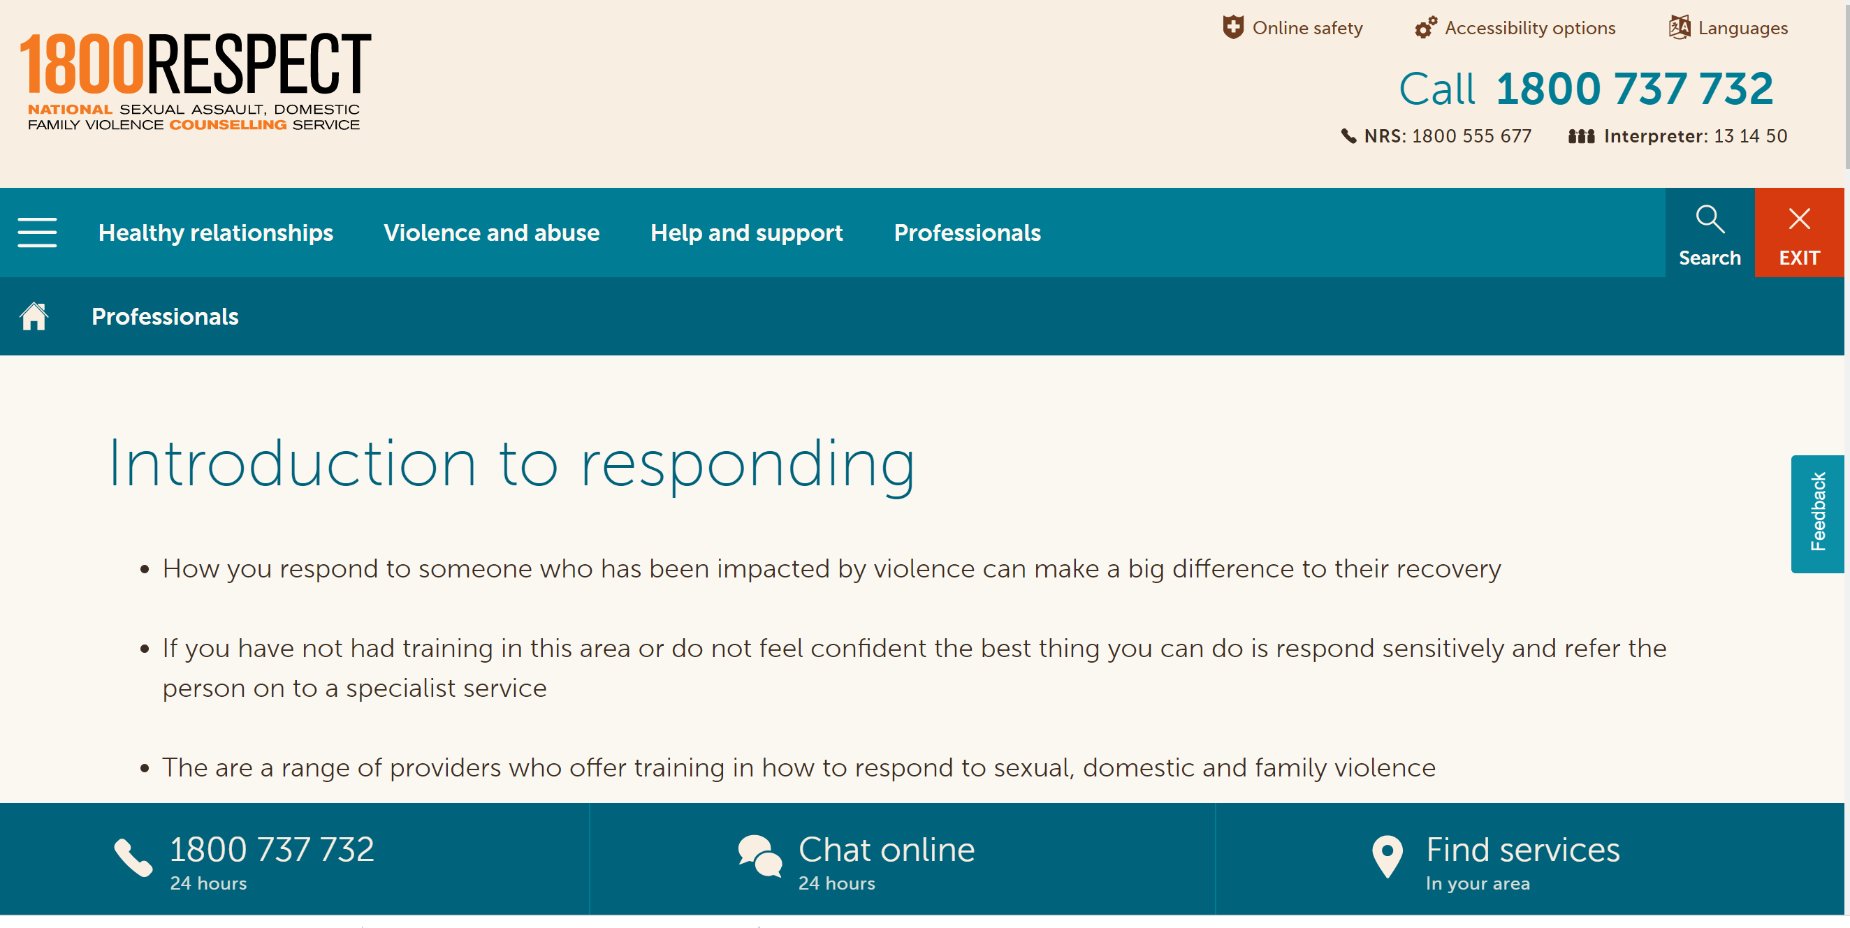
End of part 2: Where to go for more information
https://www.1800respect.org.au/introduction-to-responding/ for more information and videos on responding safely & sensitively
https://www.vic.gov.au/maram-practice-guides-and-resources for the MARAM tools and resources
41

Slide 42
FV Workplace Support policy and procedure: key features
  Acknowledges the devastating impact of FV & it is a violation of human rights
  Acknowledges that anyone can experience FV & that it is a gendered crime
  Creates a safe place for disclosures & empowers employee decision making
  Defines family violence
  Provides for 20 days of paid FV leave for full time staff (pro rata part time)
Notes:
Discussion with this slide needs to cover: How staff apply for FV leave including various options which do not include the line manager, issues related to how FV is displayed on a payslip
What can FV be used for – i.e. for victims not perpetrators -depends on your hospital
Using sick / personally leave to support someone experiencing FV
Documentary evidence – may be required
How will confidentiality be maintained
Who are the contact officers, what is their role and why do we have them - Why an employee may not want their line manager to know about a FV leave request – don’t be offended
When can I access family violence leave?
Paid family violence leave is available to any full time or part time employee who is experiencing family leave.
The purpose of the leave is to provide that staff member with the opportunity to take action that will support and enhance their safety and wellbeing. This may include
attending a medical or legal appointment,
attending court,
accessing counselling support,
relocation,
attending a family violence or other support service
staying in high security refuge accommodation
follow-up support for children in the care of that staff member.
Family violence leave is in addition to personal leave and is capped at 20 days per year (pro rata for part time staff). If additional leave is required this should be discussed with the Director, Human Resources.
Casual staff may access unpaid leave.
Who should I talk to about family violence at the Women’s?
You will need to have a conversation with a nominated person of your choice at the Women’s about your family violence situation and the type of support that you require. You can choose to talk to your direct manager or team leader about your situation if you feel comfortable to do so, or a higher level manager such as your Director or the Executive Director.
Alternatively you can choose to disclose to one of our family violence trained Human Resources Consultants, Amelia Digance ext 2901, Julia Blackburn ext 2895, Angela Grospe ext 2285, Tim Murphy ext 2923 or Mark Pardo ext 2085. The Human Resources Consultant will not share any information without your consent, however if a change to your working conditions is required, then the Human Resources will ask your permission to discuss the situation with your direct manager.
How do I apply for family violence leave?
There is a clear process outlined in our procedure and on the intranet or you can ring an HR consultant.
To keep the fact that a person is taking paid leave for family violence reasons confidential, employees will be asked to apply for sick leave using their usual process (eg RosterOn or via timesheet) in the first instance.
The Team Leader/Manager, Director, Executive Director or Human Resources Consultant will then advise the Payroll Manager of the details of the leave (ie, date, hours etc) and that the sick leave is in fact family violence leave. The Payroll Services Manager will then enter the leave as “Sick Leave Other” into the payroll system and this will appear on the payslip as “sick leave other”. This leave type is NOT sick leave and is addition to the employee’s sick leave (sometimes referred to as personal/carers leave).
It is expected that, where possible, the staff member will have a conversation regarding their situation prior to applying for leave. Where the authorising Manager has not discussed the application for leave prior to receiving it, a discreet and confidential inquiry of the staff member by the Manager or HR Consultant should be initiated to offer additional supports if required such as a workplace safety plan, flexible work conditions, referral to support services, or information regarding the Employee Assistance Program. The staff member should also be referred to the intranet for information and support for staff experiencing family violence.
Will documentation be required for family violence leave to be approved?
Supporting evidence is not required for three single days of family violence leave per year. Thereafter, evidence may include:
A statement or notice from Victoria Police
A court notice of proceedings or order
A letter or certificate from a registered health practitioner
A support letter from a family violence service, counsellor, a family support service, or other case manager
A letter from a lawyer
A statutory declaration from the staff member
This information will be retained confidentially by Human Resources and will not be placed on the staff member’s Human Resources file.
KEY MESSAGE: There is a process – policy and procedures

Slide 43
FV Workplace Support policy and procedure: key features
Workplace flexibility to be considered
Workplace Safety Planning
Confidentiality and options for people to talk to – see referral list
Sets out role for contact officers and manager responsibilities
Outlines child welfare responsibilities
Notes:
Note intranet slide and safe planning slide follow on.
This information will be retained confidentially by Human Resources and will not be placed on the staff member’s Human Resources file.
KEY MESSAGE: There is a process – policy and procedures

Slide 44
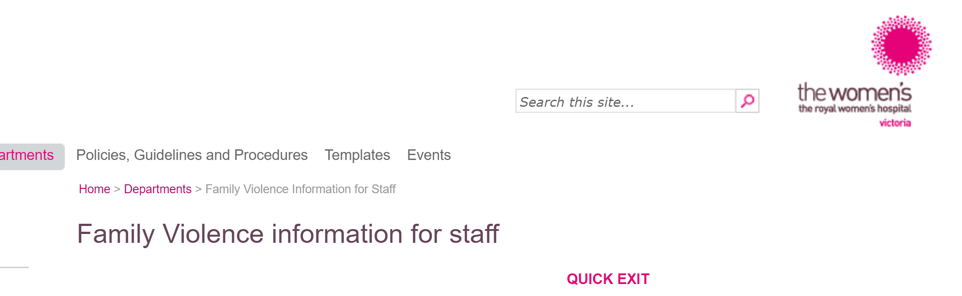

Workplace Support information for staff
Your intranet or workplace brochures
Notes:
Note that each hospital will have own intranet where store their own workplace support policies and procedures and information
https://www.thewomens.org.au/health-professionals/clinical-resources/strengthening-hospitals-response-to-family-violence/shrfv-resource-centre

Slide 45

Workplace safety planning
  The employee is the expert in their own safety and safety planning should be informed by them.
  Developed according to the needs of employee, in consultation as required with the Manager, OHS / HR, Security Manager and with any family violence specialist support services who are already involved if the employee wishes.
  Plan needs to remain confidential so only necessary persons should have a copy of the plan.
  Plan should be regularly reviewed to ensure it is up to date and as effective as is reasonably practicable.
  Different to a personal safety plan
Notes:
Each hospital should have a procedure for Workplace safety planning for staff.
This is different to a personal safety plan that is usually with a specialist service. It is recommended that a workplace one also is done in collaboration with a family violence specialist
Must always treat the employee as an expert in their own safety – not tell them there is a safety risk
If the employee identifies a safety concern work collaboratively - including the employee, manager, security manager, OHS/HR representative - to identify risk, determine options to mitigate the risk and document a plan of action
This is essentially the same approach to safety planning used with patients who identify family violence risk and seek support from the hospital or specialist services to ensure their safety
Please note: this is also done in relation to patient / visitor initiated aggression.
KEY MESSAGE: If there is a risk, we need a plan

Slide 46
Document
  The only documentation of family violence disclosures from staff must relate to:
  Records of family violence (FV) leave taken by individual staff members (FV leave record – kept by payroll)
  Records related to safety planning, work planning and performance management (secure electronic file, not personal employee file)
  HR will manage documentation.
Notes:
Tailor this to your hospital
Who will know about my family violence situation?
The Human Resources Consultant is the only staff member that will collate information related to your family violence disclosure. With your consent, your direct Manager will be informed on an ‘as needed” basis. This might include where flexible work conditions are required in response, or where team members may need to participate in a workplace safety plan (for example if reception staff are redirecting external calls to the staff member). Your consent will be required before any information is disclosed.
If a workplace safety plan is required, the Human Resources Consultant may also need to liaise with the OHS/Wellbeing Manager, security staff, and any other person that may need to be involved in the plan. This will be discussed with you first before any action is taken.
In evaluating the effectiveness of this policy, the Human Resources Consultant may provide executive staff with a report regarding the number of staff taking leave and the periods of leave taken. All information will be de-identified so that your right to privacy is maintained.​

Slide 47
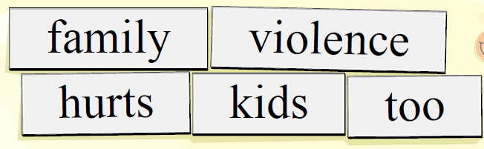
Mandatory reporting & Info sharing
Health services / hospitals should seek legal advice regarding their responsibilities related to children and reporting.
Mandatory reporting obligations where a mandated professional has concerns about the well-being of a staff members child
Obligations under the Crimes Act 1958
Obligations under the Commission for Children and Young People’s Report Conduct Scheme
Refer to Vic Gov websites for more information on Child welfare and safety
Notes:
We all have a responsibility to keep children safe and report certain conducts. If children are involved, consult with your manager / HR or legal. You can also ring a specialist services for information, providing de-identified information if you are unsure about your obligations to report.
KEY MESSAGE: We have clear reporting obligations under the law and we need to understand them.
From procedure
Child Protection / child safety reporting requirements
In your conversations with a staff member you may become aware that there are children who are or may be at risk. There are three main legislative reporting obligations which all staff members should be aware of as all staff have obligations in relation to children.
The three main legislative reporting obligations are:
1. Crimes Act (Vic) 1958 requires all adults to report to Victoria Police if there is a reasonable belief that a sexual offence has been committed by an adult against a child under the age of 16 years.
2. Reportable Conduct Scheme under the Child Wellbeing and Safety Act 2005 (the Act) requires the head of an organisation to report allegations the following by staff or volunteers of:
sexual offences against, with or in the presence of a child
misconduct against, with or in the presence of a child
physical violence against, with or in the presence of a child
behaviour that causes significant emotional or physical harm of a child
significant neglect of a child
These behaviours include but are not limited to sexual abuse, grooming, sexting, inappropriate physical contact, sexualised behaviour with a child.
Where a staff member believes any of the above may be occurring, [HR] should be immediately and confidentially notified.
3. Mandatory reporting obligations under the Children, Youth and Families Act 2005. This obligation arises for a class of employees who, in the course of practising his or her profession or carrying out the duties of his or her office, position or employment, forms the belief on reasonable grounds that a child is in need of protection. Please refer to [Mandatory Reporting Policy] for which roles have mandatory reporting obligations under the Children, Youth and Families Act 2005.
Any staff member may seek confidential advice from the Women’s in-house legal team about mandatory reporting obligations and duty of care obligations.
Reports to Child Protection or the Police should be done in a respectful and transparent manner. The limits to confidentiality should be explained prior to a conversation related to family violence to support a disclosure of family violence being made with informed knowledge of how information is shared in Victoria.
It is best practice to share information with consent and involvement of the adult victim survivor, and their information knowledge of what information is being reported so they can manage their safety and the safety of the children accordingly. Sharing information without the informed knowledge of a victim survivor of family violence can increase their risk.

Slide 48
Workplace response to perpetrators
Disclosures are not common – seek advice from HR and/or Men’s Referral Service if you become aware that someone is perpetrating FV
Our role as an employer is to provide a safe workplace / uphold code of conduct manage unacceptable behaviour if it occurs in the workplace or using workplace resources.
Prioritise the safety and needs of victim survivor when taking any action
With known perpetrators, refer to specialist services. It is not the manager’s role to screen, to do a risk assessment or to ‘rehabilitate’ the perpetrator. A referral to a specialist service also does not mean that they will stop using violence.
Beware of collusion in any conversations with the perpetrator. Keep the perpetrator accountable and in sight.
Notes:
The workplace also has a role in responding to perpetrators. Some more guidance will be coming out soon.
READ slide.
It is the role of the hospital to:
provide a safe work environment;
provide a safe clinical service for patients; and
to set and uphold expected codes of behaviour for our employees.
We manage behaviour that is inappropriate within the workplace but it is not our role to ‘rehabilitate’ the perpetrator – that is best done by specialist services.
Be aware of invitations to collude with the perpetrator.
Be aware of the obligations and options for workplace responses – OHS, discipline, code of conduct, values, Respectful Workplace Behaviours program, Reportable Conduct Scheme, criminal outcomes to proceedings and impact on registration and employment.
When managing both victim/survivor and perpetrator within the same workplace, workplace safety is our primary concern, particularly for the victim/survivor
Collusion – perpetrators are persuasive and have sophisticated ways of justifying their behaviour and eliciting sympathy and drawing in people to believe the problem lies with ‘her’ eg she is mentally unwell, incompetent etc. Be careful not to collude with this behaviour by buying in to their victim stance as this just reinforces the behaviour.
KEY MESSAGE: There are many considerations when responding to an employee who uses family violence

Slide 49
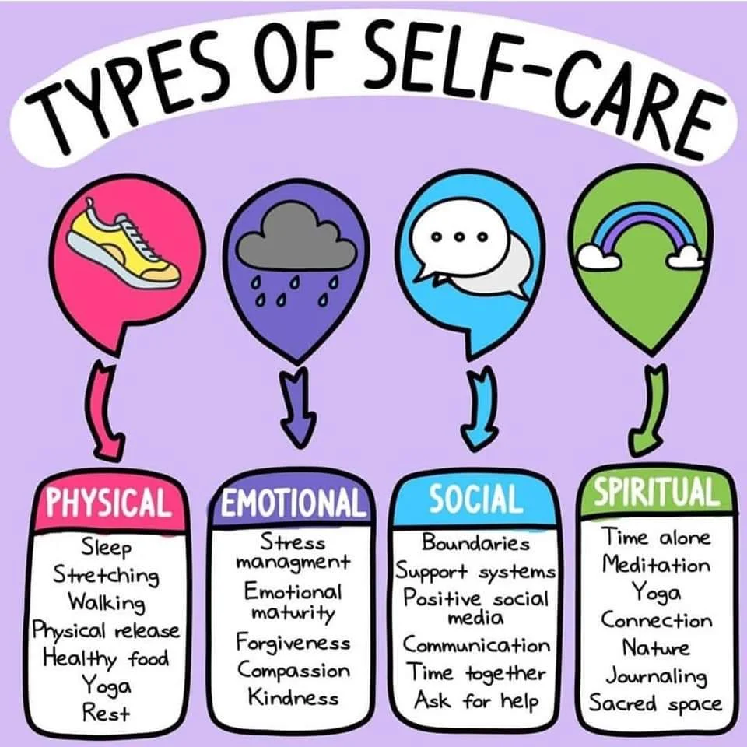
Self-care and staff care
  Working with and supporting anyone affected by family violence can have an impact.
  Contact Workplace Support Program
  Employee Assistance Program (free and confidential)
  Consider leave options
  Consider whether a critical incident session is required for staff
Notes:
KEY MESSAGE: Working with and supporting anyone affected by family violence can have an impact – take care of yourself

Slide 50
Key Messages
  Family violence is common and it affects our staff
  Family violence mostly affects women and our workforce is predominantly female
  Family violence affects workplace behaviour and performance
  A sensitive issue that requires a sensitive management response
  There is a process – policy and procedures
  You do not need to be a family violence expert – there is support
Notes:
Participants will retain the most information they hear at the commencement and conclusion of the training session. This is an opportunity to restate your key messages.
Reiterate where to go for more information

Slide 51

Thank you for all your wonderful work
  Survey reminder or link
Notes:
Thanks for coming and your commitment to a communities and workplace that are free from violence.
We now have time to questions.
We will also hand out / send around the link to a short evaluation form and I have asked if some of you are happy to have a short chat about how it went from your end.

